Slide 1

Products Catalogue

Slide 2

01. smartphones
POLAND - HUNGARY - CZECH REPUBLIC - SLOVAKIA - ROMANIA - NETHERLANDS - GERMANY - IRELAND - UK - LITHUANIA - LATVIA - ESTONIA
WWW.OVERMAX.EU

Slide 3


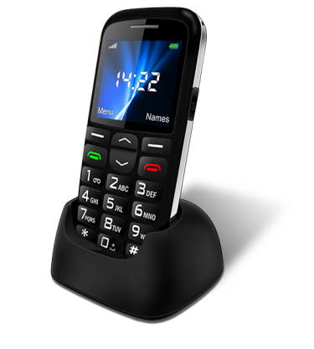
vertis 2210 easy
Phone 2,2”
The intuitive and extremely easy-to-use Vertis 2210 Easy is a phone for those who appreciate functional and affordable solutions.
Big color display
Intuitive keys
Phone book with photo contacts
SOS button
Vertis 2210 Easy is a phone designed for those who care about comfort and usefulness. With 2.2'' color display and large fonts the menu is perfectly clear and easy to read. The intuitive backlit keys and voice prompts make
using the phone easy even in low-light environment, while the photo contacts feature allows you to set up to 8 contacts with images so that you can effortlessly search and dial your friends and relatives.
POLAND - HUNGARY - CZECH REPUBLIC - SLOVAKIA - ROMANIA - NETHERLANDS - GERMANY - IRELAND - UK - LITHUANIA - LATVIA - ESTONIA
WWW.OVERMAX.EU

Slide 4








Info:
Set:
Screen: | 2.2” TFT
Memory: | 24 MB
RAM memory: | 32 MB
Back camera: | 0,3 MPx
Resolution | 220 x 176 px
System | Nucleus OS
Chipset | MTK 6261 M
MicroSD card reader | Up to 32 GB
Battery: | 1000 mAh
micro USB, Bluetooth
radio FM
Single-SIM | 850/900/1800/1900MHz
Colour: | Black
Weight: | 85 g
Dimensions: | 121 x 58 x 12.8mm
Phone
Docking station
charger
sticker
Info:
flashlight
Sos feature
Lock screen with a slider
large icons
Photo contacts
2.2”
TFT
1000mAh
Li-ion
SingleSIM,
MicroUSB,
Bluetooth
850.900/
1800/1900
vertis 2210 easy
Phone 2,2”
POLAND - HUNGARY - CZECH REPUBLIC - SLOVAKIA - ROMANIA - NETHERLANDS - GERMANY - IRELAND - UK - LITHUANIA - LATVIA - ESTONIA
WWW.OVERMAX.EU

Slide 5

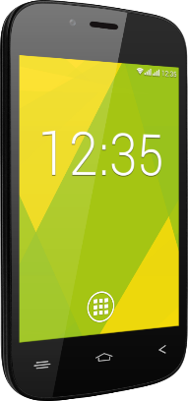

vertis 3511 you
Smartphone 3.5”
Vertis 3511 You is a perfect choice for those who appreciate small and handy smartphones. The compact 3.5" screen has been made with IPS technology ensuring the highest level of comfort. The smartphone has 4 GB of built-in memory and 512 MB of RAM. If 4GB proves to be too little space to store all your important files, you can use an SD card up to 32 GB. In order to ensure smooth operation, the device has been equipped with a quad-core processor and runs on Android 4.4.2. Vertis 3511 You has also a DualSIM module and a 3G modem, so that you can enjoy both phone calls and free Internet connection. Vertis 3511 You comes out with earphones and a protective display film.
POLAND - HUNGARY - CZECH REPUBLIC - SLOVAKIA - ROMANIA - NETHERLANDS - GERMANY - IRELAND - UK - LITHUANIA - LATVIA - ESTONIA
WWW.OVERMAX.EU

Slide 6




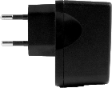
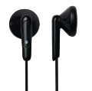




Info:
Set:
Resolution | 320*480 px
Display | 3,5” IPS
System | Android 4.4
Processor | 2x1,2 Ghz
Memory | 4GB
RAM | 512 MB
Camera | 2/0,3 MPx
3G | Yes
Dual SIM | Yes
Battery | 1500 mAh
MicroSD card slot | do 32 GB
MiniJack, | Yes
MicroUSB | Yes
GPS | Yes
Casing | Plastic
Color | Plastic
Smartphone
Charger
Protective display film
Earphones
vertis 3511 you
Applications:
POLAND - HUNGARY - CZECH REPUBLIC - SLOVAKIA - ROMANIA - NETHERLANDS - GERMANY - IRELAND - UK - LITHUANIA - LATVIA - ESTONIA
WWW.OVERMAX.EU

Slide 7

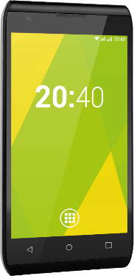
vertis 4002 you
smartphone 4.0”
Vertis 4002 You is the latest model from Overmax You smartphone line. It has a 4-inch screen with a WVGA resolution of 800x480 and runs on a quad-core processor and the latest Android 4.4.2. The smartphone has 4 GB of built-in memory and 512 MB of RAM. The device is also equipped with two cameras - the back one of 5 MP and the front one of 0.3 MP, and has microUSB and miniJack standard ports. The Dual SIM and 3G modules allow you to use both phone and free local 3G network functions at the same time. The device will be available in black and buying it you will also get a silicone case and earphones.
POLAND - HUNGARY - CZECH REPUBLIC - SLOVAKIA - ROMANIA - NETHERLANDS - GERMANY - IRELAND - UK - LITHUANIA - LATVIA - ESTONIA
WWW.OVERMAX.EU

Slide 8
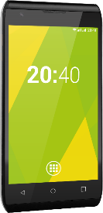

Info:
Set:
Resolution | 320*480 px
Display | 4” IPS
System | Android 4.4
CPU | 4x1,2 Ghz
Memory | 4GB
RAM | 512 MB
Camera | 5/0,3 MPx
3G | Yes
Dual SIM | Yes
Battery: | 1500 mAh
MicroSD card slot | Yes
MiniJack, | Yes
MicroUSB | Yes
GPS | Yes
Casing | Plastic
Color | Black
Smartphone
Charger
Silicon case
Earphones
vertis 4002 you
Applications:
POLAND - HUNGARY - CZECH REPUBLIC - SLOVAKIA - ROMANIA - NETHERLANDS - GERMANY - IRELAND - UK - LITHUANIA - LATVIA - ESTONIA
WWW.OVERMAX.EU

Slide 9

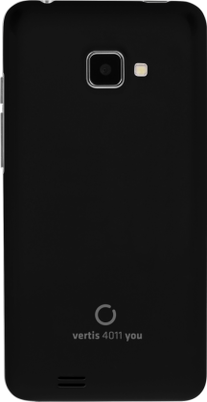
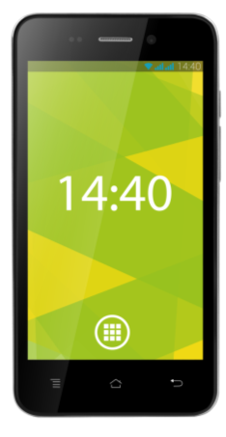
vertis 4011 you
smartphone 4” IPS2
Vertis 4011 You is a smartphone, which allows individual adjustment to the user individual needs. Android 4.4 and 4x 1,3 GHz quad-core procesor will guarantee the smooth multitasking, and the high
resolution 8 MP camera will let the user capture all the important events in a very good quality. DalSim enables to use two different phone numbers and a built-in 3G
modem and Wi-Fi will provide the Internet access anywhere you want.
POLAND - HUNGARY - CZECH REPUBLIC - SLOVAKIA - ROMANIA - NETHERLANDS - GERMANY - IRELAND - UK - LITHUANIA - LATVIA - ESTONIA
WWW.OVERMAX.EU

Slide 10
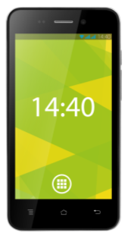

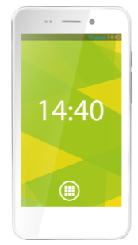















Info:
Set:
Screen: | 4.0” IPS2
Memory: | 4 GB
RAM memory: | 512 MB
Back camera: | 8.0 MPx
Front camera: | 0.3 MPx
System | Android 4.4
Processor | 4 x 1.3 GHz
Chipset | MTK 6582 M
MicroSD card reader | Up to 32 GB
Battery: | 1700 mAh
GPS, Wi-Fi, Bluetooth
Dual-SIM
MicroUSB, Mini Jack
Modem 3G | 900/2100MHz
Colour: | White/ Black
Standard:
4 colours housings, silicone case, screen protector, earphones, USB cable, charger.
Music:
Hi-Fi headset, screen protector, earphones, USB cable, charger.
vertis 4011 you
Applications:
POLAND - HUNGARY - CZECH REPUBLIC - SLOVAKIA - ROMANIA - NETHERLANDS - GERMANY - IRELAND - UK - LITHUANIA - LATVIA - ESTONIA
WWW.OVERMAX.EU

Slide 11


vertis 4501 you
smartphone 4,5”
Vertis 4501 You is a stylish smartphone for those who appreciate both the functionality and the modern design. Equipped with two cameras allows you to
capture important moments and video conferencing with loved ones or colleagues. Built-in 3G modem and WiFi provide access to the Internet at any moment,
and thanks to the 4,5” screen and compact size, the smartphone lives firmly in your hand.
POLAND - HUNGARY - CZECH REPUBLIC - SLOVAKIA - ROMANIA - NETHERLANDS - GERMANY - IRELAND - UK - LITHUANIA - LATVIA - ESTONIA
WWW.OVERMAX.EU

Slide 12
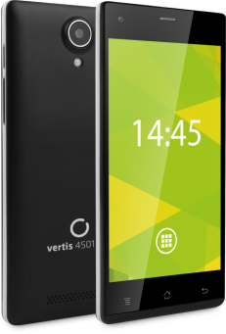


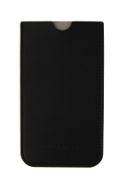



Info:
Set:
Screen: | 4.5” IPS
Memory: | 4 GB
RAM memory: | 512 MB
Back camera: | 5.0 MPx
Front camera: | 1.3 MPx
System | Android 4.4
Processor | 2 x 1.0 GHz
Chipset | MTK 6572 M
MicroSD card reader | Up to 32 GB
Battery: | 2000 mAh
GPS, Wi-Fi, Bluetooth
Dual-SIM
Micro USB, Mini Jack
Modem 3G | 900/2100MHz
Colour: | Black
Smartphone
charger
case
USB cable
headphones
Screen protecting film
Additional 2000 mAh battery
vertis 4501 you
Applications:
POLAND - HUNGARY - CZECH REPUBLIC - SLOVAKIA - ROMANIA - NETHERLANDS - GERMANY - IRELAND - UK - LITHUANIA - LATVIA - ESTONIA
WWW.OVERMAX.EU

Slide 13

vertis 5001 you
smartphone 5” IPS
Vertis 5001 You is a smartphone combining modern design, comfort of usage and high-resolution audio and camera. Due to implemented dual-core 2x 1,3 GHz processor, usage of Android 4.4 system and long-lasting 2000 mAh battery the phone will without any
complications provide simultaneous, multitasking performance for many hours. Additionally built-in 3G modem and Wi-Fi will allow surfing the Internet in all places – at work, at home or on a journey.
Furthermore DualSim module will enable having private and work phone numbers within just one device or using additional sim card slot to access the Internet.
POLAND - HUNGARY - CZECH REPUBLIC - SLOVAKIA - ROMANIA - NETHERLANDS - GERMANY - IRELAND - UK - LITHUANIA - LATVIA - ESTONIA
WWW.OVERMAX.EU

Slide 14
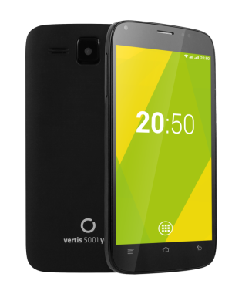
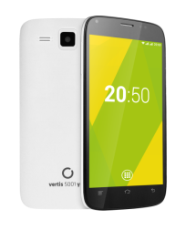

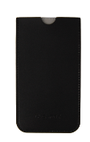

Info:
Set:
Screen: | 5” IPS
Memory: | 4 GB
RAM memory: | 512 MB
Back camera: | 5.0 MPx
Front camera: | 0.3 MPx
System | Android 4.4
Processor | 2 x 1.2 GHz
Chipset | MTK 8312
MicroSD card reader | Up to 32 GB
Battery: | 2000 mAh
GPS, Wi-Fi, Bluetooth
Dual-SIM
Micro USB, Mini Jack
Modem 3G | 900/2100MHz
Colour: | White/ Black
Smartphone
charger
case
USB cable
Screen protecting film
Additional 2000 mAh battery
vertis 5001 you
Applications:
POLAND - HUNGARY - CZECH REPUBLIC - SLOVAKIA - ROMANIA - NETHERLANDS - GERMANY - IRELAND - UK - LITHUANIA - LATVIA - ESTONIA
WWW.OVERMAX.EU

Slide 15
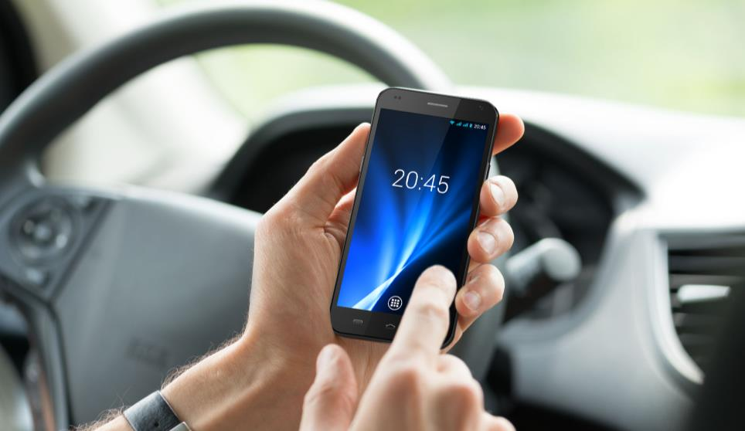
vertis 4510 expi
smartphone 4.5” IPS
It’s a stylish smartphone for those who value a high standard of finishing as well as functionality. Experience the digital world wherever you are!
Four cores and a new Android 4.4 to ensure smooth operation
8 GB of internal memory, DualSIM module, Bluetooth and GPS to enjoy additional benefits
High quality IPS QHD display ensuring excellent visual experience from any angle
We have equipped the smartphone with a wide range of preinstalled applications, such as: Wikipedia, Zumi, Nextto, Kingsoft Office, EasyCall, Avast Antivirus, N7Player. There are also two additional casings (red and blue) included making the use of the device even more enjoyable.
POLAND - HUNGARY - CZECH REPUBLIC - SLOVAKIA - ROMANIA - NETHERLANDS - GERMANY - IRELAND - UK - LITHUANIA - LATVIA - ESTONIA
WWW.OVERMAX.EU

Slide 16
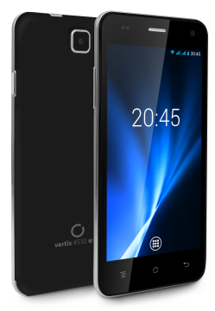
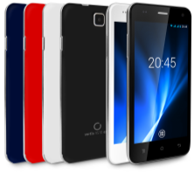
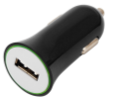


Info:
Set:
Screen: | 4.5" qHD IPS Multitouch
Memory: | 8 GB
RAM memory: | 1 GB
Back camera: | 8.0 MPx
Front camera: | 2.0 MPx
System | Android 4.4
Processor | 4 x 1.3 GHz
Chipset | MTK 6582 M
MicroSD card reader | Up to 32 GB
Battery: | 2100 mAh
GPS, Wi-Fi, Bluetooth 4.0
Dual-SIM | SIM + MicroSIM
Micro USB, Mini Jack
Modem 3G | 900/2100MHz
Colour: | White/ Black
Smartphone
charger
USB cable
headphones
car charger
Two coloured rear housing
vertis 4510 expi
Applications:
POLAND - HUNGARY - CZECH REPUBLIC - SLOVAKIA - ROMANIA - NETHERLANDS - GERMANY - IRELAND - UK - LITHUANIA - LATVIA - ESTONIA
WWW.OVERMAX.EU

Slide 17
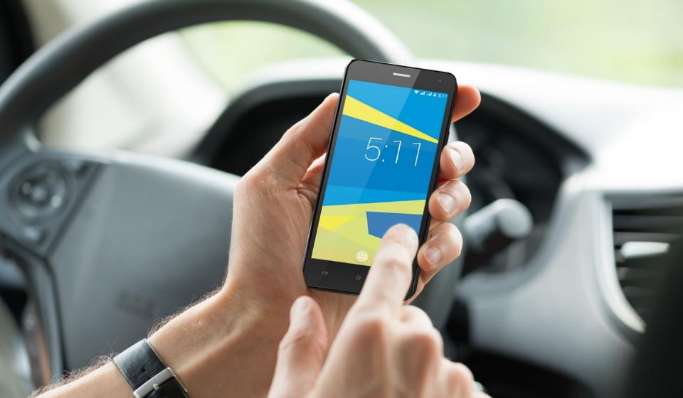

vertis 5011 expi
smartphone 5”
Vertis 5020 Aim is a smartphone for active and demanding users. The Aim smartphones are distinguished by their excellent quality and functionality. Vertis 5020 Aim is a smartphone equipped with 5-inch HD screen of IPS technology ensuring perfect color reproduction no matter from what angle you look at it. The users can enjoy the benefits of 4G LTE Internet, thanks to which the access to information has never been so simple and pleasant. The 13MP camera with autofocus allows you to take great quality photos and shoot excellent videos. Thanks to the built-in memory of 8 GB and microSD card reader supporting cards of up to 32 GB, the files can be stored directly in the memory of your smartphone. It's a perfect product for those seeking the best quality and greatest range of functionality while the saved money can be spend on something really important - business or passion. The product box also contains a car holder, car charger, case, Play starter kit and a power bank of 2000 mAh, thanks to which you don't have to worry about your battery springing an unpleasant surprise.
POLAND - HUNGARY - CZECH REPUBLIC - SLOVAKIA - ROMANIA - NETHERLANDS - GERMANY - IRELAND - UK - LITHUANIA - LATVIA - ESTONIA
WWW.OVERMAX.EU

Slide 18
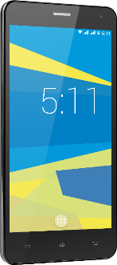

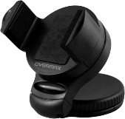



Info:
Set:
Display: | 5” HD IPS
Memory: | 8 GB
RAM: | 1 GB
Back camera: | 8 MPx
Front camera: | 0,3 MPx
System: | Android 4.4.2
Quad-core procesor: | 4 x 1.3 GHz
Resolution: | 1280 x 720
Chipset: | MTK6582
Micro SD card slot | up to 32 GB
Battery: | 1900 mAh
Micro USB, Mini Jack, GPS,
Bluetooth, WiFi,
Modem 3G | 900/2100 MHz
Dual SIM
Casing: | Plastic
Colour: | Black
Smartphone
charger
USB cable
car charger
car handle
case
headphones
vertis 5011 expi
Applications:
POLAND - HUNGARY - CZECH REPUBLIC - SLOVAKIA - ROMANIA - NETHERLANDS - GERMANY - IRELAND - UK - LITHUANIA - LATVIA - ESTONIA
WWW.OVERMAX.EU

Slide 19

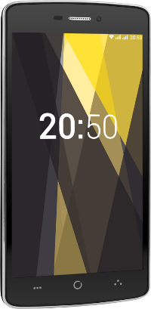
vertis 5020 aim
smartphone 5” LTE
Vertis 5020 Aim is a smartphone for active and demanding users. The Aim smartphones are distinguished by their excellent quality and functionality. Vertis 5020 Aim is a smartphone equipped with 5-inch HD screen of IPS technology ensuring perfect color reproduction no matter from what angle you look at it. The users can enjoy the benefits of 4G LTE Internet, thanks to which the access to information has never been so simple and pleasant. The 13MP camera with autofocus allows you to take great quality photos and shoot excellent videos. Thanks to the built-in memory of 8 GB and microSD card reader supporting cards of up to 32 GB, the files can be stored directly in the memory of your smartphone. It's a perfect product for those seeking the best quality and greatest range of functionality while the saved money can be spend on something really important - business or passion. The product box also contains a car holder, car charger, case, Play starter kit and a power bank of 2000 mAh, thanks to which you don't have to worry about your battery springing an unpleasant surprise.
POLAND - HUNGARY - CZECH REPUBLIC - SLOVAKIA - ROMANIA - NETHERLANDS - GERMANY - IRELAND - UK - LITHUANIA - LATVIA - ESTONIA
WWW.OVERMAX.EU

Slide 20

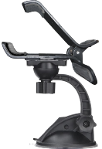




Info:
Set:
Screen: | 5” HD IPS
Memory: | 8 GB
RAM memory: | 1 GB
Back camera: | 13 MPx
Front camera: | 2 MPx
System | Android 5.1
Quad-core processor | 4 x 1.3 GHz
Chipset | MT8382 Quad Core Cortex A53
MicroSD card reader | Up to 32 GB
Battery: | 2500 mAh
GPS, Wi-Fi, Bluetooth
Dual-SIM
LTE 4G | Band 1 / Band 3 / Band 7 / Band 20
Modem 3G | 900/2100MHz
Colour:
Black + chrome
Smartphone
Car charger
Car holder
Powerbank 2000 mAh
Etui
Charger
Screen protecting film
vertis 5020 aim
Applications:
POLAND - HUNGARY - CZECH REPUBLIC - SLOVAKIA - ROMANIA - NETHERLANDS - GERMANY - IRELAND - UK - LITHUANIA - LATVIA - ESTONIA
WWW.OVERMAX.EU

Slide 21

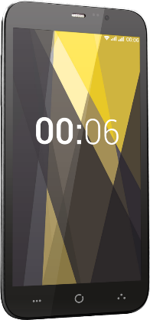
vertis 6010 aim
smartphone 6”
Vertis 6010 Aim is distinguished by its large 6-inch HD screen of IPS technology ensuring perfect color reproduction no matter from what angle you look at it. The size and quality of the screen provide the greatest comfort of use during such operations as reading documents and articles, running applications or even browsing photos and watching videos. The smartphone is equipped with two cameras - the back one (with autofocus) of 8 MP and the front one of 2 MP. The resolution of the cameras as well as 8 GB of internal memory and the microSD card reader allow you to store a reach collection of photos and videos directly in your smartphone. The set also includes a car holder, car charger and convenient case-stand.
POLAND - HUNGARY - CZECH REPUBLIC - SLOVAKIA - ROMANIA - NETHERLANDS - GERMANY - IRELAND - UK - LITHUANIA - LATVIA - ESTONIA
WWW.OVERMAX.EU

Slide 22

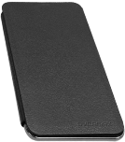

Info:
Set:
Screen: | 6” HD IPS
Memory: | 8 GB
RAM memory: | 1 GB
Back camera: | 8 MPx
Front camera: | 2 MPx
System: | Android 4.4
Quad core processor: | 4 x 1.3 GHz
Chipset | MT8382 Quad Core Cortex A7
Micro SD card slot | up to 32 GB
Battery: | 2600 mAh
GPS, Wi-Fi, Bluetooth
Dual-SIM
Modem 3G | 900/2100MHz
Colour:
Graphite chrome, rear black, rubberized
Smartphone
Car charger
Car holder
Flip cover with stand
Charger
Screen protecting film
vertis 6010 aim
Applications:
POLAND - HUNGARY - CZECH REPUBLIC - SLOVAKIA - ROMANIA - NETHERLANDS - GERMANY - IRELAND - UK - LITHUANIA - LATVIA - ESTONIA
WWW.OVERMAX.EU

Slide 23

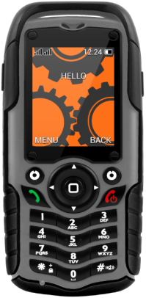

vertis kern
Phone 2” TFT
Vertis Kern is a phone designed for people of work.
Has IP67 certificate indicating the highest protection against dust and water
Dual SIM module – ability to use two SIM cards at the same time
Long- lasting battery – up to 15 days on a single charge
Reliability, durability, resistance and confidence – if you value these qualities, Kern will surely meet your expectations. The shockproof casing (IP67 certificated) is completely resistant to dust and water (the phone can be immersed in water up to one meter).
In practice, it means that Kern can be used in a workshop, a factory, a carpentry shop or on a construction site without worrying about damage or contamination. Vertis Kern is the phone you can rely on.
POLAND - HUNGARY - CZECH REPUBLIC - SLOVAKIA - ROMANIA - NETHERLANDS - GERMANY - IRELAND - UK - LITHUANIA - LATVIA - ESTONIA
WWW.OVERMAX.EU

Slide 24

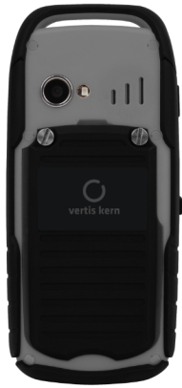

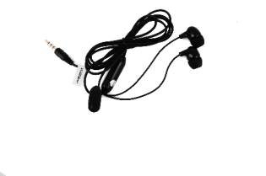





Info:
Set:
Screen: | 2” TFT
RAM memory: | 512 MB
Back camera: | 2 MPx
Flash camera
Flashlight
MicroSD card reader | Up to 32 GB
Battery: | 1300 mAh
Bluetooth, Radio FM
Dual-SIM
Resolution: | 320 x 240 px
IP 67
Colour: | grey+ black
Housing: | rubber
Phone
USB cable
charger
headphones
vertis kern
POLAND - HUNGARY - CZECH REPUBLIC - SLOVAKIA - ROMANIA - NETHERLANDS - GERMANY - IRELAND - UK - LITHUANIA - LATVIA - ESTONIA
WWW.OVERMAX.EU

Slide 25
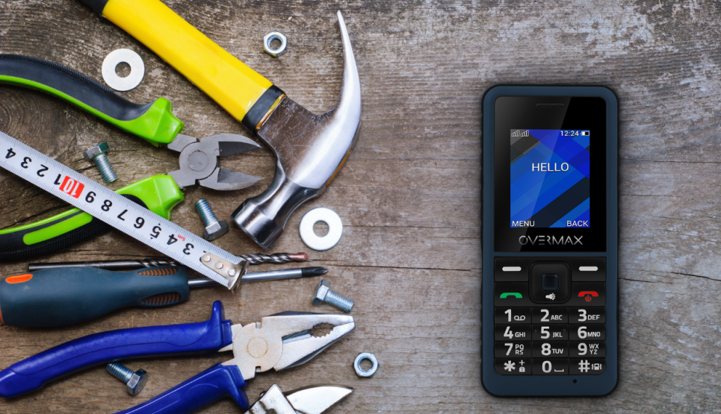

vertis 1810 kern
rugged phone
Vertis 1810 Kern is a phone dedicated to those working in difficult conditions, during which the device is constantly exposed to falls, shock and scratches.
The shockproof casing (IP 67 certificated) is resistant to dust and water, so the phone can be immersed in water up to one meter deep.
Additionally, thanks to the 1200 mAh battery, you don't have to charge your phone every single day.
POLAND - HUNGARY - CZECH REPUBLIC - SLOVAKIA - ROMANIA - NETHERLANDS - GERMANY - IRELAND - UK - LITHUANIA - LATVIA - ESTONIA
WWW.OVERMAX.EU

Slide 26
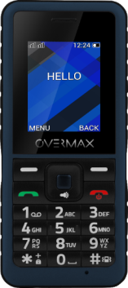
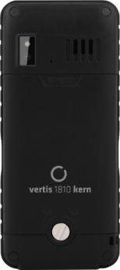
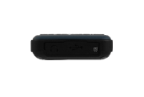



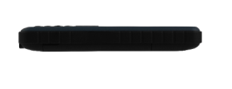




Info:
Set:
Screen: | 1,8”
Resolution: | 128x160 px
Memory: | 32 MB
Camera: | 0,3 MPx Flash camera
Flashlight
Micro USB
Jack | 3,5 mm
Bluetooth
MicroSD card reader | Up to 16 GB
Battery: | 1200 mAh
Dual SIM
Dimensions: | 115x51x16 mm
Weight: | 57 g
Housing: | Plastic
Colour: | navy blue-black
Phone
charger
USB cable
manual user
vertis 1810 kern
vertis 1810 kern
rugged phone
POLAND - HUNGARY - CZECH REPUBLIC - SLOVAKIA - ROMANIA - NETHERLANDS - GERMANY - IRELAND - UK - LITHUANIA - LATVIA - ESTONIA
WWW.OVERMAX.EU

Slide 27

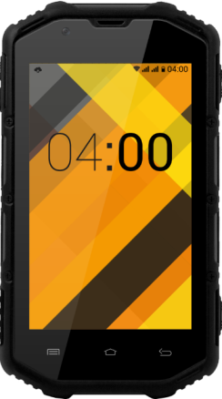

vertis braver
smartphone 4”
Vertis Braver Vertis Braver is a full-featured smartphone for adventurers and working ones. It is perfect tool for workshops, building sites or field trips. You can rely on it in even the most extreme conditions!
Waterproof, dustproof and shockproof and it is protected with rubberized housing
Quick access to the Internet (also via Wi-Fi) as well as convenient use of multimedia and applications
GPS module with a preinstalled Aponia application to safely lead you through alpine routes or during expeditions into the unknown
Vertis Braver is highly resistant to water, dust and shock, which is IP68 certified. The rubber casing elements make the smartphone fit your hand perfectly and even more effectively protected against falls and injuries. You don't have to worry about dirt, flooding or dropping your smartphone – you can safely use it in all conditions. Bet on the reliability and durability – choose Vertis Braver.
POLAND - HUNGARY - CZECH REPUBLIC - SLOVAKIA - ROMANIA - NETHERLANDS - GERMANY - IRELAND - UK - LITHUANIA - LATVIA - ESTONIA
WWW.OVERMAX.EU

Slide 28
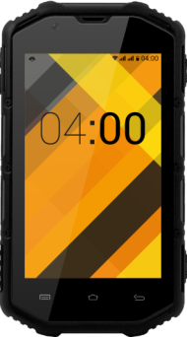
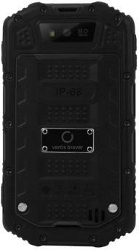
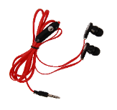
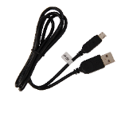
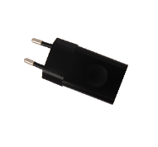
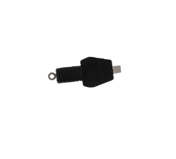

Info:
Set:
Screen: | 4”
Memory: | 4 GB
RAM memory: | 1 GB
Back camera: | 8 MPx
Front camera: | 0.3 MPx
System | Android 4.2.2
Processor | 2 x 1.2 GHz
Chipset | MTK 6572
Micro SD card slot | up to 32 GB
Battery: | 2400 mAh
GPS, Wi-Fi, Bluetooth, FM
Dual-SIM
Resolution: | 480 x 800 px
IP 68
Colour: | Black
Housing: | rubber
Smartphone
USB cable
charger
headphones
vertis braver
POLAND - HUNGARY - CZECH REPUBLIC - SLOVAKIA - ROMANIA - NETHERLANDS - GERMANY - IRELAND - UK - LITHUANIA - LATVIA - ESTONIA
WWW.OVERMAX.EU

Slide 29

selfie stick 2.1
Selfie stick 2.1 is a product created for passionate photographers, who besides shooting the photos of landscapes, sometimes like to make a great selfie. This momopod, thanks to the screwed handle may adjust to your smartphone and let you take a popular selfie. Attached you’ll also find a tripod, which allows you to take pictures form bigger distance. In addition, universal screw allows you to mount eg. sport cam or the camera and to record video materials from the new perspective. The included remote with Bluetooth technology will let you take a picture even if your smartphone is far away from the reach of your arms. Selfie stick works with devices running on Android as well as iOS. Selfie Stick 2.1 allows you to select any distance from the photographed object. The handle can reach any length in a range of 20 – 100 cm. Just download one of two dedicated apps: Google Cam or Open Camera, to enjoy the new dimension of photography.
POLAND - HUNGARY - CZECH REPUBLIC - SLOVAKIA - ROMANIA - NETHERLANDS - GERMANY - IRELAND - UK - LITHUANIA - LATVIA - ESTONIA
WWW.OVERMAX.EU

Slide 30


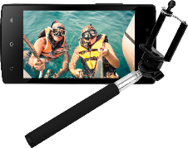

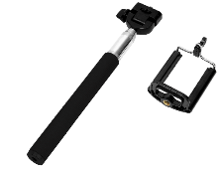
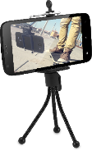
Info:
Set:
Length 20 cm – 100 cm
Material metal
comfortable, rubber handle
Bluetooth remote control
Selfie stick
Screwed holder
Tripod
Bluetooth remote control
selfie stick 2.1
POLAND - HUNGARY - CZECH REPUBLIC - SLOVAKIA - ROMANIA - NETHERLANDS - GERMANY - IRELAND - UK - LITHUANIA - LATVIA - ESTONIA
WWW.OVERMAX.EU

Slide 31

02. tablets
POLAND - HUNGARY - CZECH REPUBLIC - SLOVAKIA - ROMANIA - NETHERLANDS - GERMANY - IRELAND - UK - LITHUANIA - LATVIA - ESTONIA
WWW.OVERMAX.EU

Slide 32


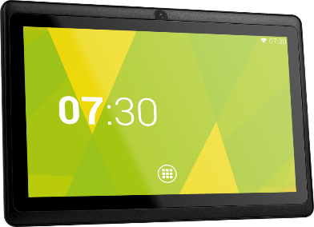
livecore 7030
tablet 7”
Livecore 7030 is the ideal solution for those who value functionality. The slight 7” tablet can be easily taken on a journey, to work, school or a meeting. The set of preinstalled applications allows you to take full advantage of all the device's features just right from the start. Android 4.4 coupled with a quad-core processor provide exceptionally smooth and efficient operation of the device. 8 GB of internal memory allows you to save all important documents, media files and applications directly in the tablet, and if it becomes full you can use a microSD card of up to 32 GB. What is more, Livecore 7030 has been equipped with an OTG port, enabling you to connect a variety of devices, including external memory.
POLAND - HUNGARY - CZECH REPUBLIC - SLOVAKIA - ROMANIA - NETHERLANDS - GERMANY - IRELAND - UK - LITHUANIA - LATVIA - ESTONIA
WWW.OVERMAX.EU

Slide 33






Info:
Set:
Screen: | 7” (800 x 480px)
Memory: | 8 GB
RAM: | 512 MB
System | Android 4.4
Camera x2 | front: 0,3 MPx back: 0,3 MPx
Processor | 4 x 1.2 GHz
Chipset | RK 3126 Quad Core Cortex A7
Micro SD card reader | Up to 32 GB
Battery: | 2500 mAh
Wi-Fi, miniJack
OTG
Case: | Black (plastic)
Tablet
USB cable
OTG cable
Charger
livecore 7030
Applications:
POLAND - HUNGARY - CZECH REPUBLIC - SLOVAKIA - ROMANIA - NETHERLANDS - GERMANY - IRELAND - UK - LITHUANIA - LATVIA - ESTONIA
WWW.OVERMAX.EU

Slide 34

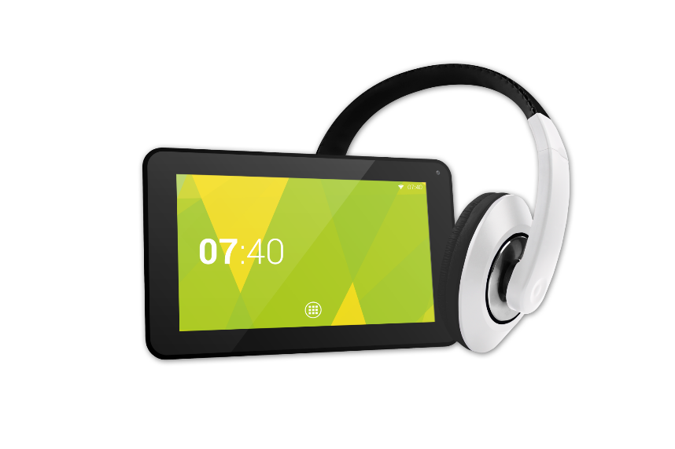
livecore 7040
tablet 7”
Livecore 7040 is a trendy tablet for all! Its 7” screen with a resolution of 1024x600px ensures and clear and vivid images. The device has been equipped with a quad-core processor and runs on a proven Android 4.4 ensuring smooth and stable operations. The 8 GB of built-in storage memory combined with a microSD card reader supporting memory cards of up to 32 GB guarantees enough space for pictures, apps and other important files. The device is equipped with two 0.3MPx cameras - a front and a back one. It also has a standard MicroUSB port and a miniJack input that you can use to connect included earphones. Livecore 7040 enables WiFi connection and is equipped with Bluetooth module that allows it to communicate with other devices. A modern design of the tablet is complemented by colour covers, as the device is available in 3 different colours: black, pink and blue.
POLAND - HUNGARY - CZECH REPUBLIC - SLOVAKIA - ROMANIA - NETHERLANDS - GERMANY - IRELAND - UK - LITHUANIA - LATVIA - ESTONIA
WWW.OVERMAX.EU

Slide 35
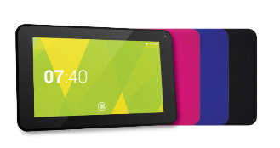
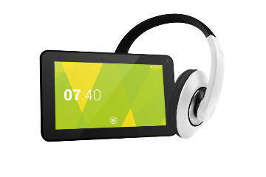




Info:
Set:
Screen | 7”
Internal memory | 8 GB
RAM | 512 MB
System | Android 4.4
Camera | 0,3 MPx/0,3 MPx
CPU | 4 x 1.3 GHz
Resolution | 1024x600
Micro SD card slot | Up to 32 GB
Battery | 2500 mAh
Wi-Fi | Yes
Bluetooth | Yes
MiniJack, MicroUSB | Yes
Casing | Plastic
Colour | Black, blue, pink
Tablet
USB cable
Earphones
Charger
livecore 7040
Applications:
POLAND - HUNGARY - CZECH REPUBLIC - SLOVAKIA - ROMANIA - NETHERLANDS - GERMANY - IRELAND - UK - LITHUANIA - LATVIA - ESTONIA
WWW.OVERMAX.EU

Slide 36

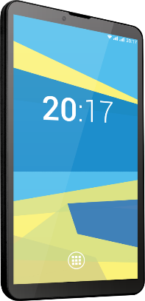
qualcore 7022 3G
tablet 7” 3G
Qualcore7022 3G is a tablet for users who seek efficiency and ability to communicate at any place. Due to its small size it is extremely portable and fits easily in a women's purse. The 7” IPS screen provides brilliant image quality and excellent visibility even at great viewing angles. The tablet also has a built-in 3G modem and Dual SIM module. This, coupled with its small size allows you to use the tablet as a smartphone. Now, you can conveniently browse the Internet as well as make phone calls. The Quadcore 4x1.3 GHz processor and 1 GB of RAM ensure smooth operation of multiple tasks simultaneously. The device is equipped with two built-in cameras - the front one of 0.3 MP and the back one of 2 MP. Qualcore 7022 3G also has 8GB of built-in memory and a microSD card reader supporting memory cards of up to 32 GB. In addition to the tablet the product box contains a charger, a USB cable and an OTG cable.
POLAND - HUNGARY - CZECH REPUBLIC - SLOVAKIA - ROMANIA - NETHERLANDS - GERMANY - IRELAND - UK - LITHUANIA - LATVIA - ESTONIA
WWW.OVERMAX.EU

Slide 37



Info:
Set:
Display: | 7” IPS
Memory: | 8 GB
RAM: | 1 GB
System | Android 4.4
Dual SIM with phone function
2 x camera | front: 0,3 MP back: 2 MP
Modem 3G | 900/2100MHz
Quad-core processor | 4 x 1.3 GHz
Chipset | SC7731 Quad Core Cortex A7
Micro SD card slot | up to 32 GB
Battery: | 2500 mAh
GPS, Wi-Fi, Bluetooth
OTG
Colour: | Black
Tablet
USB cable
OTG cable
Charger
qualcore 7022 3G
Applications:
POLAND - HUNGARY - CZECH REPUBLIC - SLOVAKIA - ROMANIA - NETHERLANDS - GERMANY - IRELAND - UK - LITHUANIA - LATVIA - ESTONIA
WWW.OVERMAX.EU

Slide 38


qualcore 7030 4G
tablet 7” 4G
Qualcore 7030 4G is the first Overmax tablet that supports super-fast LTE networks! A quad-core processor combined with proven Android 5.1 ensures smooth operation of the device. Thanks to the 7-inch screen the tablet is extremely compact and handy.
Qualcore 7030 4G is equipped with as much as 8 GB of internal storage. The tablet also has all the necessary features such as: a micro USB input, a micro SD card reader, a mini jack input and a Bluetooth module. A WiFi module combined with an LTE modem ensures
stable and convenient Internet connection at any time and place. Due to the 2000 mAh battery the device is also exceptionally efficient. In addition to the tablet the product box contains a USB cable and a Play starter kit.
POLAND - HUNGARY - CZECH REPUBLIC - SLOVAKIA - ROMANIA - NETHERLANDS - GERMANY - IRELAND - UK - LITHUANIA - LATVIA - ESTONIA
WWW.OVERMAX.EU

Slide 39



Info:
Set:
System | Android 5.1
CPU | 4 x 1.0 GHz
Screen | 7”
Resolution | 1024 x 600
RAM | 1 GB
Memory | 8 GB
Battery | 2000 mAh
Dual SIM | YES
Camera x2 | front: 0,3 MP back: 2 MP
Micro USB, Mini Jack | YES
Micro SD card reader: | up to 32 GB
GPS, Wi-Fi, Bluetooth,OTG | YES
LTE | YES
Colour: | Black
Tablet
USB cable
OTG cable
Charger
Play starter kit
qualcore 7030 4G
Applications:
POLAND - HUNGARY - CZECH REPUBLIC - SLOVAKIA - ROMANIA - NETHERLANDS - GERMANY - IRELAND - UK - LITHUANIA - LATVIA - ESTONIA
WWW.OVERMAX.EU

Slide 40

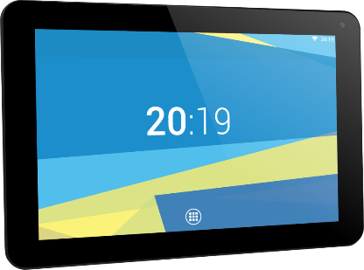
qualcore 9010
tablet 9”
Qualcore 9010 is an exceptionally functional tablet with 9-inch screen. In order to make it easier to perform multiple demanding tasks simultaneously, the tablet is equipped with a quad-core 4 x 1.2 GHz processor and runs on Android 4.4 operating system. As much as 8 GB of internal memory and the built-in microSD card reader supporting memory cards of up to 32 GB allow you to install dozens of games and applications as well as to create your own photo gallery directly in the tablet. Photo and video galleries can be made thanks to the two built-in cameras - the back one (of 2MP resolution) and the front one (0.3 MP). The quad-core 4 x 1.2 GHz processor and 1GB of RAM provide smooth running of many applications simultaneously, while the 3800 mAh battery ensures long and steady operation of the device. The set also includes a charger, a USB cable and an OTG cable.
POLAND - HUNGARY - CZECH REPUBLIC - SLOVAKIA - ROMANIA - NETHERLANDS - GERMANY - IRELAND - UK - LITHUANIA - LATVIA - ESTONIA
WWW.OVERMAX.EU

Slide 41



Info:
Set:
Display: | 9” HD
Memory: | 8 GB
RAM: | 1 GB
System | Android 4.4
2 x camera | front: 0,3 MP back: 2 MP
Quad-core processor | 4 x 1.2 GHz
Chipset | Allwinner Quad Core Cortex A7
Micro SD card slot | up to 32 GB
Battery: | 3800 mAh
Wi-Fi
OTG
Colour: | Black
Tablet
USB cable
OTG cable
Charger
qualcore 9010
Applications:
POLAND - HUNGARY - CZECH REPUBLIC - SLOVAKIA - ROMANIA - NETHERLANDS - GERMANY - IRELAND - UK - LITHUANIA - LATVIA - ESTONIA
WWW.OVERMAX.EU

Slide 42


qualcore 1020 3G
tablet 10.1” 3G
Qualcore 1020 3G is the next tablet from the Qualcore line, distinguished by 10.1-inch screen. The screen has been made in a way so that the user can comfortably use the device in all circumstances - to browse the web at work as well as to watch movies at home. The tablet has a built-in 3G modem allowing you to fully enjoy access to mobile Internet at almost any place, and DualSIM module - two SIM card slots so that the second card can be used to make phone calls. The device is equipped with two cameras - the front one of 0.3 MP and the back one of 2 MP. Those, who love photos or applications, will certainly not complain about the lack of memory - the device has 8 GB of internal memory and a built-in microSD card reader supporting memory cards of up to 32 GB. 1 GB of RAM coupled with a quad-core 4x1.3 GHz processor ensures comfortable use of many demanding applications simultaneously. In addition to the tablet the product box contains a USB cable, an OTG cable and a charger.
POLAND - HUNGARY - CZECH REPUBLIC - SLOVAKIA - ROMANIA - NETHERLANDS - GERMANY - IRELAND - UK - LITHUANIA - LATVIA - ESTONIA
WWW.OVERMAX.EU

Slide 43



Info:
Set:
Display: | 10.1”
Memory: | 8 GB
RAM: | 1 GB
System | Android 4.4
Dual SIM with phone function
2 x camera | front: 0,3 MP back: 2 MP
Modem 3G | 900/2100MHz
Quad-core processor | 4 x 1.3 GHz
Chipset | SC7731 Quad Core Cortex A7
Micro SD | do 32 GB
Battery: | 5200 mAh
GPS, Wi-Fi, Bluetooth
OTG
Colour: | Black
Tablet
USB cable
OTG cable
Charger
Keyboard
qualcore 1020 3G
Applications:
POLAND - HUNGARY - CZECH REPUBLIC - SLOVAKIA - ROMANIA - NETHERLANDS - GERMANY - IRELAND - UK - LITHUANIA - LATVIA - ESTONIA
WWW.OVERMAX.EU

Slide 44


qualcore 1030 4G
tablet 10.1” 4G
Qualcore 1030 4G is a unique 4G tablet from the Qualcore line. Due to its 10.1 HD screen and wide viewing angles, browsing photos or watching movies with your friends has never been so easy! A built-in 4G modem and a DualSim module allow you to enjoy super-fast LTE Internet access and make phone calls at the same time.
1 GB of RAM coupled with a quad-core processor ensures comfortable use of many demanding applications simultaneously.
The device is equipped with two cameras - the front one of 0.3 MP and the back one of 2 MP.
As the device has as many as 8 GB of internal storage space and a built-in microSD card reader supporting memory cards of up to 32 GB, it is extremely easy to capture the most memorable moments and create an own photo gallery directly in the tablet. In addition to the tablet the product box contains a case, a USB cable, an OTG cable and a charger.
kabel OTG oraz ładowarka.
POLAND - HUNGARY - CZECH REPUBLIC - SLOVAKIA - ROMANIA - NETHERLANDS - GERMANY - IRELAND - UK - LITHUANIA - LATVIA - ESTONIA
WWW.OVERMAX.EU

Slide 45




Info:
Set:
Screen | 10.1” HD IPS
Memory | 8 GB
RAM | 1 GB
Operating System | Android 5.1
Dual SIM with phone function | YES
4G LTE | YES
2 x camera | front: 0,3 MP back: 2 MP
4G | YES
Processor | 4 x 1.0 GHz 64-bit
Chipset | MTK8735M Quad Core Cortex A7
MicroSD card reader | Up to 32 GB
Battery | 4000 mAh
GPS, Wi-Fi, Bluetooth 4.0 | YES
OTG | YES
Colour | Black
Tablet
OTG cable
USB cable
charger
case
TP Protector
power supply
qualcore 1030 4G
LTE
HD
ips
Applications:
POLAND - HUNGARY - CZECH REPUBLIC - SLOVAKIA - ROMANIA - NETHERLANDS - GERMANY - IRELAND - UK - LITHUANIA - LATVIA - ESTONIA
WWW.OVERMAX.EU

Slide 46


steelcore 1020 3G
tablet 10.1” 3G
Steelcore 1020 3G tablet will meet the expectations of the most demanding users. Its 10-inch IPS 2 screen provides comfort of use and the highest image quality. The quad-core 4 x 1.6 GHz processor coupled with 2GB of RAM and Adnroid 4.4 operating system ensures exceptionally smooth operation during even the most demanding tasks. The Dual SIM module allows you to use both phone and 3G network functions at the same time. Steelcore 1020 3G is also equipped with two cameras – the front one of 0.3 MP and back one (with autofocus) of 8 MP. 16 GB of internal memory and built-in microSD card reader supporting memory cards of up to 32 GB ensure that you will never run out of space for your photos and applications. The metal casing makes the device extremely robust while the long-life battery of 6000 mAh provides many hours of continuous operation. The set also includes a charger, USB cable and OTG cable.
POLAND - HUNGARY - CZECH REPUBLIC - SLOVAKIA - ROMANIA - NETHERLANDS - GERMANY - IRELAND - UK - LITHUANIA - LATVIA - ESTONIA
WWW.OVERMAX.EU

Slide 47




Info:
Set:
Display: | 10.1” HD IPS2
Memory: | 16 GB
RAM: | 2 GB
System | Android 4.4
Dual SIM with phone function
2 x camera | front: 2 MPx back: 8 MPx AF
Modem 3G | 900/2100MHz
Quad-core processor | 4 x 1.6 GHz
Chipset | MTK 8382 Quad Core Cortex A7
Micro SD card slot | up to32 GB
Battery: | 6000 mAh
GPS, Wi-Fi, Bluetooth
OTG
Housing: | Black metal + plastic
Tablet
USB cable
OTG cable
Charger
steelcore 1020 3G
Applications:
POLAND - HUNGARY - CZECH REPUBLIC - SLOVAKIA - ROMANIA - NETHERLANDS - GERMANY - IRELAND - UK - LITHUANIA - LATVIA - ESTONIA
WWW.OVERMAX.EU

Slide 48

03. drones
POLAND - HUNGARY - CZECH REPUBLIC - SLOVAKIA - ROMANIA - NETHERLANDS - GERMANY - IRELAND - UK - LITHUANIA - LATVIA - ESTONIA
WWW.OVERMAX.EU

Slide 49


x-bee drone 1.0
drone 10 cm
X-Bee Drone 1.0 is the smallest representative of Overmax drones family. Unimposing 10 centimetres size drone provides unforgettable entertainment and incredible fun both outdoors and indoors. The flight time is up to 7 minutes on a single battery charge.
During this time you can perform amazing 360-degree stunts operating the drone at 3 different speed levels. In order to make it easier to learn how to pilot a drone, it has been equipped with an auto-calibration function and headless mode ensuring perfectly accurate operation regardless of the drone and pilot's position.
The drone has been designed in a way so that you can use it also inside a house within the operating range of up to 40 metres. It comes out with 4 spare propellers ensuring your fun will not be stopped by any unexpected event.
POLAND - HUNGARY - CZECH REPUBLIC - SLOVAKIA - ROMANIA - NETHERLANDS - GERMANY - IRELAND - UK - LITHUANIA - LATVIA - ESTONIA
WWW.OVERMAX.EU

Slide 50


Info:
Set:
Size | 10 cm
Flight time | up to 7 min
Remote control | YES
Operating range | up to 40 m
Gyroscope | 6-axis
360-degree stunts | YES
CPU speed | 3 modes
Lights | LED
Headless mode | YES
Auto-calibration | YES
Color | Black
a drone
a remote control
8 propellers
battery
USB cable
x-bee drone 1.0
dron 10 cm
POLAND - HUNGARY - CZECH REPUBLIC - SLOVAKIA - ROMANIA - NETHERLANDS - GERMANY - IRELAND - UK - LITHUANIA - LATVIA - ESTONIA
WWW.OVERMAX.EU

Slide 51

x-bee drone 1.1
drone
X-Bee Drone 1.1 is one of the smallest representative s of Overmax X-Bee drones’ family. In spite of its compact size (a diagonal of 17 cm) it is a wonderful toy guaranteeing incredible fun both for older kids and adults. Thanks to the 6-axis gyroscope X-Bee Drone 1.1 allows you to perform amazing 360-degree stunts just like in case of its bigger brothers, while the headless mode makes it definitely easier to control the device. This mode ensures perfectly accurate operation regardless of the drone and pilot's position. 3 flight speed modes allow for easier control of the device, while the durable battery provides up to 10 minutes of flying. Thanks to the professional remote control you can operate your drone within a range of up to 100 meters. Bright LED lights make your drone perfectly visible even from a great distance. The light indicator also allows you to see a low battery warning. In the product box you will also find 8 protected propellers, a USB charger and a remote control.
POLAND - HUNGARY - CZECH REPUBLIC - SLOVAKIA - ROMANIA - NETHERLANDS - GERMANY - IRELAND - UK - LITHUANIA - LATVIA - ESTONIA
WWW.OVERMAX.EU

Slide 52



Info:
Set:
Size | 17cm
Flight time | Up to 10 minutes
Remote control | YES
Operating range | Up to 100m
Gyroscope | 6-axis
Stunts | 360-degree
Speed | 3 levels
Lights | LED
Headless mode | YES
Low battery indicator YES
Color: Black - orange
drone
8 propellers
propeller protectors
remote control
USB charger
x-bee drone 1.1
drone
POLAND - HUNGARY - CZECH REPUBLIC - SLOVAKIA - ROMANIA - NETHERLANDS - GERMANY - IRELAND - UK - LITHUANIA - LATVIA - ESTONIA
WWW.OVERMAX.EU

Slide 53


x-bee drone 2.1
drone with camera
X-Bee Drone 2.1 is a 27-centimeter drone equipped with a camera that allows you to take amazing aerial pictures and shoot videos from the bird's eye view perspective. The headless mode makes it definitely easier to control the device - the feature ensures perfectly accurate operation regardless of the drone and pilot's position. Therefore, the drone always flies precisely in a direction indicated by a remote control operator. During the flight and aerobatics (possible thanks to the 6-axial gyroscope) the device can be operated with 3 different speed modes. During 10 minutes of fun you can operate the drone within a range of up to 100 meters while the LED lights make it easy to locate the device even at dusk. What is more, the light indicator also allows an operator to see a low battery warning. The drone comes out with a wide range of accessories such as 8 propellers with protectors, a camera with a built-in SD card reader, a 1-GB SD card and a charger.
POLAND - HUNGARY - CZECH REPUBLIC - SLOVAKIA - ROMANIA - NETHERLANDS - GERMANY - IRELAND - UK - LITHUANIA - LATVIA - ESTONIA
WWW.OVERMAX.EU

Slide 54






Info:
Set:
Size | 27cm
Flight time | Up to 7 minutes
Remote control | YES
Operating range | Up to 100 m
Camera | Yes
Gyroscope | 6-axis
Stunts | 360-degree
Speed | 3 levels
Lights | LED
Headless mode | YES
Low battery indicator
Colour: Black (with orange propellers)
drone
camera with a built-in SD card reader
1-GB SD card
8 propellers
propeller protectors
remote control
battery charger
x-bee drone 2.1
drone with camera
POLAND - HUNGARY - CZECH REPUBLIC - SLOVAKIA - ROMANIA - NETHERLANDS - GERMANY - IRELAND - UK - LITHUANIA - LATVIA - ESTONIA
WWW.OVERMAX.EU

Slide 55


x-bee drone 2.2
drone 35 cm
X-Bee Drone 2.2 is one of the latest Overmax drones. The device has no propeller protectors and is incredibly fast and nimble. The drone flies in 2 different speed modes, while the 6-axis gyroscope enables it to
perform 360-degree stunts in an amazingly smooth manner. The LED lights make it easy to control the drone within the operating range of up to 80 meters. The device comes out with 3 batteries that allow you
to play with it for as many as 30 minutes (10-minute flight with each battery)! What is more, in the product box you can also find 2 battery chargers and 8 spare propellers.
POLAND - HUNGARY - CZECH REPUBLIC - SLOVAKIA - ROMANIA - NETHERLANDS - GERMANY - IRELAND - UK - LITHUANIA - LATVIA - ESTONIA
WWW.OVERMAX.EU

Slide 56





Info:
Set:
Size | 35 cm
Flight time | up to 30 min
Remote control | YES
Operating range | up to 80 m
Gyroscope | 6-axis
CPU speed | 2 modes
360-degree stunts | YES
Lights | LED
Colour | Black
a drone
a remote control
12 propellers
3 batteries
2 battery chargers
x-bee drone 2.2
dron 35 cm
POLAND - HUNGARY - CZECH REPUBLIC - SLOVAKIA - ROMANIA - NETHERLANDS - GERMANY - IRELAND - UK - LITHUANIA - LATVIA - ESTONIA
WWW.OVERMAX.EU

Slide 57

x-beedrone 3.1
drone 34 cm with camera HD
Overmax X-Bee Drone 3.1 is a device equipped in 2 Mpix resolution camera, allowing to record movies from bird’s-eye. Thanks to the three 700 mAh batteries attached to the set, user may enjoy flight for even 30
min! Moreover thanks to 6 axis gyroscope, the drone may do many aerial acrobatics – 360° turns,
nose-dives, striking barrel rolls or flying on the left or right side. Solid structure based on four propellers will make X-Bee Drone 3.1 always fly precise under the given course. X-Bee Drone 3.1 has an attached remote controller, that enables navigating the drone from over 300m!
New Overmax drone is available in 3 color versions – white, black and camo. Every user can choose color according to his style. Set includes also additional propellers kit, thanks to which the flight will never be interrupted by unforeseen contingency.
POLAND - HUNGARY - CZECH REPUBLIC - SLOVAKIA - ROMANIA - NETHERLANDS - GERMANY - IRELAND - UK - LITHUANIA - LATVIA - ESTONIA
WWW.OVERMAX.EU

Slide 58






Info:
Set:
Camera | 2 MP
Flight time | Up to 30 min
Battery | 700mAh
6 axis gyroscope
Number of propellers | 4
Stunts | 360 degrees
Lights | LED
Remote control
Opreating range | Up to 100m
Colour | Black-black, black-white, white-red
propeller protectors
Size | 34 cm
Drone
remote controller
3 batteries
8 propellers
battery USB charger
2GB memory card
card reader
screwdriver
range
stunts
x-bee drone 3.1
drone 34 cm with camera HD
POLAND - HUNGARY - CZECH REPUBLIC - SLOVAKIA - ROMANIA - NETHERLANDS - GERMANY - IRELAND - UK - LITHUANIA - LATVIA - ESTONIA
WWW.OVERMAX.EU

Slide 59


x-bee drone 3.2
drone with camera & accessories
X-Bee Drone 3.2 is a new, improved version of the already popular X-Bee Drone 3.1. The 40-centimeter drone is equipped with 3 batteries ensuring up to 30 minutes of incredible fun (10 minutes each). Headless mode makes it easy to control the device even for novice users, ensuring perfectly accurate operation regardless of the drone and pilot's position. Therefore, the drone always flies precisely in a direction indicated by a remote control operator. Comfort of the operation is also improved by a remote control with a display and 2 flight speed modes. It has been equipped with a 6-axis gyroscope, ensuring smooth performance of a wide range of 360-degree aerobatics. The drone can be operated within a range of up to 100 meters and the auto-return function ensures its safe return to the starting place. Thanks to the camera not only can you take aerial pictures but also shoot videos during the flight. The drone comes out with a wide range of accessories: 16 propellers with protectors, a camera with a built-in SD card reader, a 1-GB SD card, a screwdriver and mounting screws.
POLAND - HUNGARY - CZECH REPUBLIC - SLOVAKIA - ROMANIA - NETHERLANDS - GERMANY - IRELAND - UK - LITHUANIA - LATVIA - ESTONIA
WWW.OVERMAX.EU

Slide 60






Info:
Set:
Size | 30 cm
Flight time | Up to 30 minutes
Remote control with a display | YES
Operating range | Up to 100m
Camera | 2 MPx
Gyroscope | 6-axis
Stunts 360 degree | YES
Speed | 2 modes
Lights | LED
Headless mode
Auto-return
Low battery light indicator
Colour: Black (with orange propellers)
drone
camera
SD card reader
1-GB SD card
16 propellers
propeller protectors
remote control with a display
3 batteries
2 battery chargers
screwdriver with mounting screws
x-bee drone 3.2
drone with camera & accessories
POLAND - HUNGARY - CZECH REPUBLIC - SLOVAKIA - ROMANIA - NETHERLANDS - GERMANY - IRELAND - UK - LITHUANIA - LATVIA - ESTONIA
WWW.OVERMAX.EU

Slide 61


x-bee drone 3.5
drone 36 cm
X-Bee Drone 3.5 is a nimble drone with a diameter of 36 cm and a 10-minute flight time. This is the first Overmax drone that can be operated directly with a smartphone using a dedicated application. The drone is equipped with a camera so that you can take aerial photos and videos and save them directly in the memory of a paired smartphone. When the drone is paired with a smartphone you can also use FPV function that allows the operator to see the images from the drone's camera directly on the smartphone's screen. X-Bee Drone 3.5 performs all popular aerial stunts at three speed levels. The drone can be operated within a range of up to 80 meters and the LED lights ensure that you will never lose sight of the device. The drone comes out with a wide range of accessories: 12 propellers, 3 batteries, 2 chargers, a screwdriver and screws.
POLAND - HUNGARY - CZECH REPUBLIC - SLOVAKIA - ROMANIA - NETHERLANDS - GERMANY - IRELAND - UK - LITHUANIA - LATVIA - ESTONIA
WWW.OVERMAX.EU

Slide 62


Info:
Set:
Size | 36 cm
Flight time | up to 10 min
FPV
Auto-return
It can be controlled with a smartphone
Camera | 0,3 MP
File storage
Remote control
Gyroscope | 6-axis
CPU speed | 3 modes
360-degree stunts
Lights | LED
Operating range | up to 80 m
Colour | Orange-black
a drone
a remote control
12 propellers
propeller protectors
3 batteries
2 battery chargers
a screwdriver
screws
x-bee drone 3.5
drone 36 cm
POLAND - HUNGARY - CZECH REPUBLIC - SLOVAKIA - ROMANIA - NETHERLANDS - GERMANY - IRELAND - UK - LITHUANIA - LATVIA - ESTONIA
WWW.OVERMAX.EU

Slide 63


x-bee drone 5.1
drone 56 cm
X-Bee Drone 5.1 - a big drone with a big heart! The device of a diagonal of 56 centimeters can be operated within a range of up to 100 meters and allows you for 30-minute flights. Manual calibration has been superseded by an intelligent automatic calibration. The device is equipped with an auto-return function allowing the drone to fly back a dozen meters towards the last safe position. With the built-in camera, SD card reader and included 2-GB memory card you can also see and record the images from the bird's eye view perspective. The remote control is equipped with a display allowing you to see current functions and speed modes.
POLAND - HUNGARY - CZECH REPUBLIC - SLOVAKIA - ROMANIA - NETHERLANDS - GERMANY - IRELAND - UK - LITHUANIA - LATVIA - ESTONIA
WWW.OVERMAX.EU

Slide 64


Info:
Set:
Size | 56 cm
Flight time | up to 30 min
Remote control | YES
Operating range | up to 100 m
Camera | 2 MP
File storage | On the memory card
Memory card reader | YES
Gyroscope | 6-axis
360-degree stunts | YES
CPU speed | 2 modes
Lights | LED
Intelligent calibration
Colour | Black-orange
a drone
a remote control
12 propellers
propeller protectors
3 batteries
2 battery chargers
a screwdriver
screws
x-bee drone 5.1
dron 56cm
POLAND - HUNGARY - CZECH REPUBLIC - SLOVAKIA - ROMANIA - NETHERLANDS - GERMANY - IRELAND - UK - LITHUANIA - LATVIA - ESTONIA
WWW.OVERMAX.EU

Slide 65


x-bee drone 6.1
drone 44,5 cm
X-Bee Drone 6.1 is the first 6-propeller drone from Overmax. Its diagonal is 44.5 centimeters while the maximum flight time is 10 minutes. The drone is fully compatible with smartphones - due to the dedicated application it is possible to control the device with a smartphone. The included camera allows you to see the world from above and take aerial pictures and videos that can be stored directly in the smartphone's memory. The 6-axis gyroscope allows you to perform complex aerobatics using 3 different speed modes. X-Bee Drone 6.1 has LEDlights and an operating range of up to 80m. In the product box you will also find a remote control with a smartphone holder (up to 6"), 18 propellers, 2 batteries, 2 chargers, 6 propeller protectors, 6 screws, a screwdriver and 2 landing skids.
POLAND - HUNGARY - CZECH REPUBLIC - SLOVAKIA - ROMANIA - NETHERLANDS - GERMANY - IRELAND - UK - LITHUANIA - LATVIA - ESTONIA
WWW.OVERMAX.EU

Slide 66

Info:
Set:
Size | 44,5 cm
Flight time | Up to 10 min
Six propellers
Camera | YES
Remote control with a smartphone holder (up to 6")
It can be controlled with a smartphone
File storage | in a smartphone's memory
Headless mode
Gyroscope | 6-axis
CPU speed | 3 modes
360-degree stunts
Lights | LED
Operating range: | Up to 80 m
Color | Black-silver
a Dron
a remote control with a smartphone holder (up to 6")
18 propellers
propeller protectors
2 batteries
a charger
a screwdriver and screws
x-bee drone 6.1
dron 44,5 cm
POLAND - HUNGARY - CZECH REPUBLIC - SLOVAKIA - ROMANIA - NETHERLANDS - GERMANY - IRELAND - UK - LITHUANIA - LATVIA - ESTONIA
WWW.OVERMAX.EU

Slide 67

04. sports products
POLAND - HUNGARY - CZECH REPUBLIC - SLOVAKIA - ROMANIA - NETHERLANDS - GERMANY - IRELAND - UK - LITHUANIA - LATVIA - ESTONIA
WWW.OVERMAX.EU

Slide 68



activecam 2.2
sports camera
Activecam 2.2 is a sports camera - a perfect tool to capture your sports performances and all unforgettable moments in extreme conditions. The camera records Full HD 1080i videos of amazing quality, while the 2-inch LCD provides live view of the recorded images and allows you to playback previously recorded videos. Additionally, the camera system comes out with an option to turn off the screen during recording, which makes Activecam 2.2 even more efficient. What is more, the camera is equipped with two 900 mAh batteries (included) providing even longer recording time. Activecam 2.2 is equipped with many useful features and add-ons. The micro SD card reader allows you to expand the device's memory up to 32 GB. Thanks to the loop recording function the camera automatically overwrites the recorded videos, so you don't have to constantly replace your micro SD card. The camera has a built-in microphone and speaker allowing you to record sound and hear it while playing back the videos. The camera can be mounted in almost any place, therefore contributing greatly to the dynamism of your videos. The set includes such accessories as mounting clips and waterproof case.
POLAND - HUNGARY - CZECH REPUBLIC - SLOVAKIA - ROMANIA - NETHERLANDS - GERMANY - IRELAND - UK - LITHUANIA - LATVIA - ESTONIA
WWW.OVERMAX.EU

Slide 69







Info:
Set:
Resolution | Full HD 1920*1080 - 15 fps
Display | 2”
Viewing angle: | 140 degrees
Photos: | 5MP
Loop recording
PC camera
Speaker, Microphone
Format video: | .mov
Format photos: | .jpg
Battery: | 900 mAh
MicroSD card reader | up to 32 GB
Micro USB
shockproof
The camera feature car
Color: | black, blue
2 batteries, a waterproof case, a handlebar clip, a helmet mount, a windshield suction, a car charger, a quick-mount clip,
a charger, a USB cable.
activecam 2.2
sports camera
POLAND - HUNGARY - CZECH REPUBLIC - SLOVAKIA - ROMANIA - NETHERLANDS - GERMANY - IRELAND - UK - LITHUANIA - LATVIA - ESTONIA
WWW.OVERMAX.EU

Slide 70


activecam 3.2
sports camera
Activecam 3.2 is a multi-function sports camera that thanks to the 170-degree viewing angle allows you to capture all of your sports feats. 1080p resolution and up to 30 fps ensure the highest recording quality. The device also allows you to take pictures of 2M, 5M, 8M, and even 18! They are saved as jpg. files
Other camera features are:
loop recording - the oldest files are overwritten by the newer ones;
autostart - the device starts automatically when it detects the power. This function is particularly useful when the device is used as a car camera;
storage mode
Activecam 3.2 is a sports camera designed in such a way that it can be used in all conditions. Equipped with a wide range of accessories it allows you to record video
in any situation. The waterproof case allows you to capture underwater adventures, while two included 900 mAh batteries double the recording time! Additionally, the product box includes all kinds of mounting tools allowing you to attach the camera to variety of sports equipment or mount it in the car, and (optionally) the case with another set of accessories.
POLAND - HUNGARY - CZECH REPUBLIC - SLOVAKIA - ROMANIA - NETHERLANDS - GERMANY - IRELAND - UK - LITHUANIA - LATVIA - ESTONIA
WWW.OVERMAX.EU

Slide 71


Info:
Set:
Resolution | 1080 p do 30 FPS
Display | 1,5”
Viewing angle: | 170 degrees
Photos: | 2M / 5M / 8M / 12M
Loop recording
Autostart
Storage mode
Format video: | .mov, .h264
Format photos: | .jpg
Battery: | 2x 900 mAh
MicroSD card reader | up to 32 GB
Micro HDMI, Wi-Fi
Microphone, Screen timeout
Colour: | black, silver
2 batteries, a waterproof case, a handlebar clip, a helmet mount, a quick-mount clip, a set of mount tapes, a car handle,
a car charger, a charger, a USB cable.
Optionally, the case with extra tools (a monopod, a helmet strap, a float handle, set of floaty sponges)
activecam 3.2
sports camera
POLAND - HUNGARY - CZECH REPUBLIC - SLOVAKIA - ROMANIA - NETHERLANDS - GERMANY - IRELAND - UK - LITHUANIA - LATVIA - ESTONIA
WWW.OVERMAX.EU

Slide 72


activecam 3.3
Sports camera
Activecam 3.3 is a sports camera that allows you to capture all adrenaline moments! This small camcorder can be attached either to a helmet, board, bicycle frame, monopod or a floaty sponge. Activecam 3.3 records full HD (1920x1080) videos at the speed of 30 frames per second. The 2-inch LCD screen provides live view of recorded videos. The large viewing angle (as much as 170 degrees!) ensures astonishingly wide images, while the waterproof case allows you to shoot amazing videos straight from the water. Due to the autostart function you can also use your Activecam 3.3 as a car camera. It is equipped with a wireless remote recording trigger and comes out with a wide range of accessories: mount holders (a helmet, a frame and a surfboard one), an armband, a USB cable, a car holder, a car charger, an extra battery, a waterproof case, a remote control, floaty sponge holders, a monopod and a suitcase allowing you to hold the equipment.
POLAND - HUNGARY - CZECH REPUBLIC - SLOVAKIA - ROMANIA - NETHERLANDS - GERMANY - IRELAND - UK - LITHUANIA - LATVIA - ESTONIA
WWW.OVERMAX.EU

Slide 73










Info:
Set:
Display | LCD 2”
Viewing angle | 170 degrees
Recording resolution | Full HD 1920*1080
Autostart | Yes
Pictures | 3mp/5mp/8mp/10mp/12mp
Optional resolution | 720p / 60 fps
MicroSD card reader | Up to 32 GB
Autostart | Yes
Loop recording | Yes
Sound | Yes
Wi-Fi | Yes
Car camera mode
Frame rate | 30 fps
Waterproof case up to 30 meters
Battery | 1200 mAh
Remote control | Yes
Camera, mount holders (a helmet, a frame and a surfboard one), an armband, a USB cable, a car holder, a car charger, an extra battery, a waterproof case, a remote control, floaty sponge holders, a monopod and an accessory suitcase.
activecam 3.3
Sports camera
POLAND - HUNGARY - CZECH REPUBLIC - SLOVAKIA - ROMANIA - NETHERLANDS - GERMANY - IRELAND - UK - LITHUANIA - LATVIA - ESTONIA
WWW.OVERMAX.EU

Slide 74

05. Home audio & video
POLAND - HUNGARY - CZECH REPUBLIC - SLOVAKIA - ROMANIA - NETHERLANDS - GERMANY - IRELAND - UK - LITHUANIA - LATVIA - ESTONIA
WWW.OVERMAX.EU

Slide 75



multipic 2.1
projector
We present the light and handy projector with built-in speakers, remote zoom function and adjustable aspect ratio. View videos, photos and business presentations on up to 100” projection screen. The natural color saturation and perfectly rectangular shape of the screen – discover a new dimension of experience with Multipic 2.1!
TFT LCD screen
Built-in speakers not to bother about cables or additional devices
Allows to choose the aspect ratio (16: 9 or 4: 3) and to rotate the image by up to 360 degrees
Compact dimensions (17×13,6×7 cm)
Multipic 2.1 allows you to project images with a diagonal of up to 100'' as well as to choose the aspect ratio (16: 9 or 4: 3) and to rotate the image by up to 360 degrees. Thanks to these you will easily match the projection to your preferences. With the remote zoom feature no detail will escape your attention, while the image correction (up to 15 degrees) tool ensures perfectly rectangular projection without any distortion. Create the cinema experience at home!
POLAND - HUNGARY - CZECH REPUBLIC - SLOVAKIA - ROMANIA - NETHERLANDS - GERMANY - IRELAND - UK - LITHUANIA - LATVIA - ESTONIA
WWW.OVERMAX.EU

Slide 76








Info:
Set:
Image size: | 30-100”
Native resolution: | 320 x 480 px
Brightness: | 150 Lux
Lamp type: | LED 30W
Contrast ratio: | 500:1
Image: | 16:9, 4:3
Noise intensity: | <25 dB
Image rotation: | 360 degrees
Operating temperature range: | Up to 0° - 50°
Zoom: | remote, electric
KEYSTONE correction
HD Support | 1080p
Interfaces | USB/SD/AVG/HDMI/AV/MicroUSB
Color: | white
Size: | 170x136x70mm
Multilanguage menu
Projector multipic 2.1
a power cable
a Jack - Chinch composite cable
a remote control
User manual
Warranty card
100” zoom
0,8kg 1080p
multipic 2.1
POLAND - HUNGARY - CZECH REPUBLIC - SLOVAKIA - ROMANIA - NETHERLANDS - GERMANY - IRELAND - UK - LITHUANIA - LATVIA - ESTONIA
WWW.OVERMAX.EU

Slide 77


multipic 2.2
projector
Overmax Multipic 2.2 is a projector that is perfectly suited for both home usage and business presentations. Due to its small size and weight as little as 1 kg, it can be easily installed wherever you need it. The device displays the image of 800x400 px while still supporting 1080x720 px. It allows you to choose a preferable aspect ratio (16:9 or 4:3) and display images with a diagonal of up to 130"! The device has a zoom feature and a Keystone correction tool ensuring perfectly rectangular image regardless of the projection angle. The projector has been also equipped with all necessary connectors 2x USB, SD, HDMI, AV and IR. These features, combined with a low noise level (<25dB) and a high contrast, make the using of Multipic 2.2 extremely comfortable. Optionally, the set can be expanded by a portable projection screen that will allow you to perform presentations in any setting.
POLAND - HUNGARY - CZECH REPUBLIC - SLOVAKIA - ROMANIA - NETHERLANDS - GERMANY - IRELAND - UK - LITHUANIA - LATVIA - ESTONIA
WWW.OVERMAX.EU

Slide 78








Info:
Set:
Image size: | 34-130”
Resolution: | 800 x 480 px
Brightnes: | 800 Lux
Lamp: | LED 55W
Contrast: | 800:1
Display: | 16:9, 4:3
Noise: | <25 dB
Rotation: | 180 degrees
SD card slot: | Up to 32 GB
Zoom: | yes
KEYSTONE correction | yes
HD Support | 1080p, 720p
Interfaces | USB1/USB2/SD/HDMI/AV/IR
Color: | White + black
Size: | 201x151x67,5 mm
Multilanguage menu
Projector multipic 2.2
Power cable
Lens cover
3 in 1 AV wire
Remote
User manual
Warranty card
Portable screen 60”
multipic 2.2
POLAND - HUNGARY - CZECH REPUBLIC - SLOVAKIA - ROMANIA - NETHERLANDS - GERMANY - IRELAND - UK - LITHUANIA - LATVIA - ESTONIA
WWW.OVERMAX.EU

Slide 79


multipic 3.1
projector
We present our high-end multimedia projector with built-in speakers ensuring even more convenient display of movies, photos and presentations on a big screen. Enjoy excellent picture quality with a diagonal up to 140” and 1000:1 contrast. With the remote controlled zoom and keystone correction feature the displayed projection is perfectly rectangular and tailored to your needs.
Multipic 3.1 provides the amazing image clarity and natural color reproduction therefore making projected movies and pictures extraordinarily vivid and deep. The 5" LCD screen with a triplet lens ensures the image size up to 140'' with 1000:1 contrast and brightness of 2000 lumens. The lifespan of the projector's lamp is 50 000 hours, which guarantees nearly five years of non-stop watching!
Multipic 3.1 is an easy-to-use device allowing you to adjust the projection to your preferences. So you can select a preferable aspect ratio (16:9 or 4:3), rotate the projection by up to 360 degrees or remotely adjust zoom.
POLAND - HUNGARY - CZECH REPUBLIC - SLOVAKIA - ROMANIA - NETHERLANDS - GERMANY - IRELAND - UK - LITHUANIA - LATVIA - ESTONIA
WWW.OVERMAX.EU

Slide 80








Info:
Set:
Image size: | 50-140”
Native resolution: | 800 x 480 px
Brightness: | 2,000 Lux
Lamp type: | LED 100W
Contrast ratio: | 1000:1
Image: | 16:9, 4:3
Noise intensity: | <25 dB
Image rotation: | 360 degrees
Operating temperature range: | Up to 0° - 50°
Zoom: | remote, electric
KEYSTONE correction
HD Support | 1080p, 720p
Interfaces | HDMI1/HDMI2/USB1/USB2/AV/AVG/YPbPr/ATV
Color: | Grey
Size: | 330x257x105mm
Multilanguage menu
Projector multipic 3.1
a power cable
a Jack - Chinch composite cable
a remote control
User manual
Warranty card
140” zoom
3kg 1080p
multipic 3.1
POLAND - HUNGARY - CZECH REPUBLIC - SLOVAKIA - ROMANIA - NETHERLANDS - GERMANY - IRELAND - UK - LITHUANIA - LATVIA - ESTONIA
WWW.OVERMAX.EU

Slide 81

OV-Screen
Adjustable projection screen
The latest Overmax projection screen offers a high level of functionality for those who love watching movies on a big screen. The compact 60-inch screen is a lightweight and easy-to-use accessory - a real "must have" in your home theater. Adjustable height and length of the Overmax projection screen make it a perfect device for both home and office everyday use. The high quality of the screen ensures natural color reproduction and no distortion of the projected images. The sturdy and folding device with a wind-up mechanism metal case can be easily stored in a closet or moved in a car trunk, allowing you to project presentations wherever you want!
POLAND - HUNGARY - CZECH REPUBLIC - SLOVAKIA - ROMANIA - NETHERLANDS - GERMANY - IRELAND - UK - LITHUANIA - LATVIA - ESTONIA
WWW.OVERMAX.EU

Slide 82





Info:
Set:
Number of inches | 60"
Operating surface | 122 x 92 cm
Maximum height of the pulled down screen: | 119 cm
Thickness of the case: | 7 cm
Leg spacing: | 80 cm
Type: | Tripod base
Canvas color: | whitemat
Frame color: | black
Canvas color (back): | black
Screen:
- Folding design
- Wind-up mechanism case
- Automatic, spring screent retraction
- Stable tripod
- Screen height adjustment
- Screen position adjustment
Manual
OV-Screen
Adjustable projection screen
POLAND - HUNGARY - CZECH REPUBLIC - SLOVAKIA - ROMANIA - NETHERLANDS - GERMANY - IRELAND - UK - LITHUANIA - LATVIA - ESTONIA
WWW.OVERMAX.EU

Slide 83


camspot 3.1
wireless camera
We present the wireless camera with a rotating lens with wide range of adjustment, as well as remote and manual automatic movement feature. Thanks to the Night Mode and ten IR LEDs the recorded image is clear and easy to read even in complete darkness. Camspot 3.1 also has a built-in speaker and microphone, memory card reader, motion detector and what is more, it allows wireless Wi-Fi communication.
IR Cut filter – clear and sharp images with a perfect color reproduction and free of IR reflections.
Works perfectly as a baby monitor as well – thanks to AJT app possibility to display the image from your house or work camera on your smartphone or tablet.
Camspot 3.1 allows you to control the rotation within a
range of 320 degrees horizontally and 120 degrees vertically. So you do not have to worry about where to install the camera in order to provide the best visibility. At these view angles it is possible to carefully monitor the whole room. You can easily connect Camspot 3.1 to a LAN or wireless Wi-Fi network and then manage the camera images seeing them on your computer screen no matter where you are.
POLAND - HUNGARY - CZECH REPUBLIC - SLOVAKIA - ROMANIA - NETHERLANDS - GERMANY - IRELAND - UK - LITHUANIA - LATVIA - ESTONIA
WWW.OVERMAX.EU

Slide 84


Info:
Set:
Viewing angle | Vertically 120°, horizontally 355°
Resolution | HD 720p (1280 x 720@25 fps)
Motion detection
speaker
microphone
Night vision
10 diod IR
IR Cut
Wi-Fi
Color | Black, white
Operating temperature range | Up to 0°C - 50°
charger
an antenna
a bracket
mounting set
an ethernet cable
simple operation
Wi Fi
Ethernet I/O
Connectivity with other devices
night
mode
observation
camspot 3.1
wireless camera
POLAND - HUNGARY - CZECH REPUBLIC - SLOVAKIA - ROMANIA - NETHERLANDS - GERMANY - IRELAND - UK - LITHUANIA - LATVIA - ESTONIA
WWW.OVERMAX.EU

Slide 85



camspot 3.2
Camspot 3.2 is a perfect solution to your worries about the unattended house! This camcorder allows you to record up to 7 days of security videos and store them directly in a memory card. It has an advanced motion detection function, and, once paired with a smartphone, it can notify the user about a possible threat. Camspot 3.2 can also record sound, and the 10 IR LEDs provide night vision mode. Due to the wide viewing angle combined with HD resolution you can be sure that the camera will never miss the slightest detail. What is more, the camcorder has also an alarm function. Detected motion triggers a loud alarm indicating that something undesirable is happening in the monitored area. Camspot 3.2 also allows you to send live (real-time) audio stream, so you can personally respond when you see an unwelcome guest on the screen. The camcorder comes out with a free 32-GB microSD card.
POLAND - HUNGARY - CZECH REPUBLIC - SLOVAKIA - ROMANIA - NETHERLANDS - GERMANY - IRELAND - UK - LITHUANIA - LATVIA - ESTONIA
WWW.OVERMAX.EU

Slide 86







Info:
Set:
Chipset | Huawei Hi3518E
Video | H.264
Viewing angle | Vertically 120°, Horizontally 355°
Resolution | HD, 720P(1280×720@ 25 fps)
Networks | P2P, Wi-Fi, LAN
Motion detection alarm | Yes
MicroSD | Up to 32 GB
Supported systems | iOS (5.0 or later), Android (2.3 or later), IE, CMS (Windows )
IR LED’s | 10
Sound | Yes
Night mode | Yes
Colour | Black and white
Camera
Power supply
Antenna
Wall mount
32-GB micro SD card
camspot 3.2
POLAND - HUNGARY - CZECH REPUBLIC - SLOVAKIA - ROMANIA - NETHERLANDS - GERMANY - IRELAND - UK - LITHUANIA - LATVIA - ESTONIA
WWW.OVERMAX.EU

Slide 87

camspot 4.1
outdoor camera
Camspot 4.1 outdoor camera is a device designed for continuous monitoring of the area outside the house, office or any other building. Monitor your surroundings regardless of the weather and at any time of the day or night, in order to ensure the safety of you and your family!
720p HD resolution ensures excellent image quality and allows you to record all the details.
Thanks to the motion sensor the camera turns on automatically after detection of an approaching object and sends the snapshot directly to the previously indicated email address.
Camspot 4.1 is equipped with many features ensuring its proper operation and allowing to record high-quality videos. Night Vision and Dual IR Cut functions as well as 30 IR LEDs provide sharp and clear images at any time of the day or night. The IP66 waterproof rating and broad range of operating temperatures (from -20°C to 50°C) allow you to be sure that the device will never let you down! During both warm summer days and cold winter nights, the camera will always record what is going on around your place, in order to provide safety and comfort to your family.
POLAND - HUNGARY - CZECH REPUBLIC - SLOVAKIA - ROMANIA - NETHERLANDS - GERMANY - IRELAND - UK - LITHUANIA - LATVIA - ESTONIA
WWW.OVERMAX.EU

Slide 88

Info:
Set:
Viewing angle | 60°
Resolution | HD 720p (1280 x 720@25 fps)
IP 66
Motion detection
speaker
microphone
Night vision
30 diod IR
Dual IR Cut
Wi-Fi
Color | White
Operating temperature range | Up to -20°C - 50°
a power supply
an antenna
a mount
mounting set
simple operation
Wi Fi
Ethernet I/O
Connectivity with other devices
night
mode
IP 66
camspot 4.1
outdoor camera
POLAND - HUNGARY - CZECH REPUBLIC - SLOVAKIA - ROMANIA - NETHERLANDS - GERMANY - IRELAND - UK - LITHUANIA - LATVIA - ESTONIA
WWW.OVERMAX.EU

Slide 89



Rotating
head
355°/85°
camspot 4.2
Camspot 4.2 is an outdoor camera that allows you to monitor the area around your house or office, regardless of the time of day or night. Getting a mobile access to the cameras is plain sailing. You just need a smartphone, tablet or laptop to display the live stream from a given camera within a few clicks.
Due to the HD 720p resolution the images are detailed and of an excellent quality. Night Vision, Dual IR Cut and 22 built-in IR LEDs provide sharp and clear images at any time of the day or night.
The rotating head allows you to remotely adjust the position of the camera within the range of:
- 355 degrees horizontally,
- 85 degrees vertically.
POLAND - HUNGARY - CZECH REPUBLIC - SLOVAKIA - ROMANIA - NETHERLANDS - GERMANY - IRELAND - UK - LITHUANIA - LATVIA - ESTONIA
WWW.OVERMAX.EU

Slide 90




Info:
Set:
Chipset | Hisilicon 3518E
Video | H.264
Viewing angle Rotating head | range of adjustment: 355°/ 85°
Resolution | HD, 720P(1280×720@25fps)
Networks | P2P, Wi-Fi, LAN TCP/IP
Motion detection
ONVIF | support
Supported systems | iOS (5.0 or later), Android (2.3 or later), IE
Leds | IR Led x 22 + IR Cut
Sound | Speaker, Microphone
Night mode
Colour | white
Camera
a power supply
an antenna
a mounting set
a handle
an Ethernet cable
a manual
HD
720p
355°/85°
Wi-Fi
camspot 4.2
POLAND - HUNGARY - CZECH REPUBLIC - SLOVAKIA - ROMANIA - NETHERLANDS - GERMANY - IRELAND - UK - LITHUANIA - LATVIA - ESTONIA
WWW.OVERMAX.EU

Slide 91



homebox 4.1
Homebox 4.1 is an innovational product which allows user to transfer vision form WiFi devices, like computer or tablet, to the tv screen. User can play movie on computer browser and transfer it through WiFi to the TV. Smooth device work is guaranteed by CPU Octacore 8 x 1,5 GHz and system Android 5.1. Moreover device has 2GB RAM and 8GB buld-in memory. Homebox 4.1 plays 4K resolution and supports H.265 with 60 fps. It has 2 USB, HDMI and MicroUSB inputs. Homebox 4.1 is also equipped with MicroSD card reader, WiFi and Bluetooth. Wireless screen function and DLNA function are additional advantages of the device. With Homebox 4.1 every user gets QWERTY keyboard with airmouse, remote control, HDMI and AV cable.
POLAND - HUNGARY - CZECH REPUBLIC - SLOVAKIA - ROMANIA - NETHERLANDS - GERMANY - IRELAND - UK - LITHUANIA - LATVIA - ESTONIA
WWW.OVERMAX.EU

Slide 92





Info:
Set:
CPU: | Octacore 8 x 1,5 GHz
System: | Android 5.1
Resolution: | plays 4K supports H.265 with 60 fps
RAM: | 2 GB
Memory: | 8 GB
Micro SD card slot | up to 32 GB
HDMI, Micro USB, USB x2,
Bluetooth, WiFi
IR
SPIDIF
RJ45
Wireless screen function
DLNA function
RKRemote aplication
Homebox 4.1
Qwerty keyboard with airmouse
Remote control
HDMI cable
AV cable
Power supply cable
homebox 4.1
POLAND - HUNGARY - CZECH REPUBLIC - SLOVAKIA - ROMANIA - NETHERLANDS - GERMANY - IRELAND - UK - LITHUANIA - LATVIA - ESTONIA
WWW.OVERMAX.EU

Slide 93


soundbox 2.1
wireless audio transmitter
Soundbox 2.1 is a wireless audio transmitter that will replace your traditional hi-fi, home theater devices or speakers with a wireless sound system. From now on you can listen to your favorite music streaming it wirelessly from your smartphone, tablet, laptop or PC!
Wireless audio transmitter
Home Wi-Fi network booster
Soundbox 2.1 is a perfect solution for those Hi-Fi users who want to use their own music collection stored on their computers, tablets or smartphones.
The transmitter is conveniently connected to your home Wi-Fi network enabling each device within it to send music to the Soundbox and play it using a home audio system.
The device also increases the range and strength of a home Wi-Fi signal.
POLAND - HUNGARY - CZECH REPUBLIC - SLOVAKIA - ROMANIA - NETHERLANDS - GERMANY - IRELAND - UK - LITHUANIA - LATVIA - ESTONIA
WWW.OVERMAX.EU

Slide 94



Info:
Set:
Processor | Qualcomm Atheros
Compatibility | 802.11b/g/n (Max150Mbps)
Supported systems | Android, iOS
Supported audio formats | mp3, wav, flac. Airplay: aac, mp3
Connectors | Micro USB, SPDIF(optical audio), USB, 3,5mm JACK
Audio frequency | 24bit,96kHZ
Weight | 40 g (+/-2g)
Operating temperature range | 0 - 50°C
Dimensions | 85x85x24,7mm
Color | Black
Compatible with DLNA / UPnP
a power supply
micro USB cable
a Jack - Chinch composite cable
soundbox 2.1
wireless audio transmitter
POLAND - HUNGARY - CZECH REPUBLIC - SLOVAKIA - ROMANIA - NETHERLANDS - GERMANY - IRELAND - UK - LITHUANIA - LATVIA - ESTONIA
WWW.OVERMAX.EU

Slide 95

06. automotive products
POLAND - HUNGARY - CZECH REPUBLIC - SLOVAKIA - ROMANIA - NETHERLANDS - GERMANY - IRELAND - UK - LITHUANIA - LATVIA - ESTONIA
WWW.OVERMAX.EU

Slide 96


ad-01
alcohol detector
AD-01 breathalyzer is an intuitive and easy-to-use device that allows you to check concentration of the alcohol in your breath. Now, before any scheduled trip you can easily check whether you are allowed to drive. Use Overmax AD-01 to take care of the safety of your loved ones and other road users!
• The device is equipped with an audio warning system and emits a beep sound indicating a failed attempt, low battery voltage and alerting you when breath alcohol concentration reaches the value above the acceptable level.
• Quick response (about 5s) and preparation time (18s)
POLAND - HUNGARY - CZECH REPUBLIC - SLOVAKIA - ROMANIA - NETHERLANDS - GERMANY - IRELAND - UK - LITHUANIA - LATVIA - ESTONIA
WWW.OVERMAX.EU

Slide 97




Info:
Set:
Accuracy | 0,01 mg/l
Range | 0,00 – 1,00 mg/l
Sensor | semiconductor
Display | LCD
Operating temperature | -10 - 40°
Preparation time | 18 sek.
Response time | ok. 5 sek.
Power supply | 3x AAA
breathalyser
10 mouthpieces
USB cable
a car adapter
case
user manual
Audio warning:
- failed attempt,
- alcohol concentration beyond
the acceptable level,
- low battery voltage
ad-01
alcohol detector
POLAND - HUNGARY - CZECH REPUBLIC - SLOVAKIA - ROMANIA - NETHERLANDS - GERMANY - IRELAND - UK - LITHUANIA - LATVIA - ESTONIA
WWW.OVERMAX.EU

Slide 98



camroad 2.3
car camera
It is a functional and easy-to-use car camera, perfect for car travels. Camroad 2.3 is an indispensable travel companion!
Records in full HD (1920*1080p at 25 fps)
Has a wide viewing angle (120 stopni)
As many as 12 IR LEDs for even better recording quality at night and during adverse weather conditions
Track every mile of the road in Full HD! 120-degree wide-angle lens makes the images fluent and full of details, while the handy 1.5" LCD screen ensures
constant overview of the recorded route as well as the access to variety of settings. Camroad 2.3 is also equipped with 12 IR LEDs that provide the excellent recording quality even at night or during bad weather conditions. Now you won't miss the slightest detail of your travelled road!
POLAND - HUNGARY - CZECH REPUBLIC - SLOVAKIA - ROMANIA - NETHERLANDS - GERMANY - IRELAND - UK - LITHUANIA - LATVIA - ESTONIA
WWW.OVERMAX.EU

Slide 99






Info:
Set:
Screen | LCD 1.5” TFT
Viewing angle | 120 degrees
Resolution | Full HD 1920*1080
Frame rate | 30 fps
Pictures | 12M / 10M / 8M / 5M / 3M / 2M / VGA / 1,3M
Loop recording | off / 2 / 3 / 5 / 10 min
12 diod IR | Night vision
Autostart
Chipset | NTK96220
G-Sensor
MicroSD card support up to 32 GB at least class 6th
microphone
Screen timeout
Battery | 200 mAh
Colour | black
Casing | rubberized
Car charger
USB cable
a holder
camroad 2.3
car camera
POLAND - HUNGARY - CZECH REPUBLIC - SLOVAKIA - ROMANIA - NETHERLANDS - GERMANY - IRELAND - UK - LITHUANIA - LATVIA - ESTONIA
WWW.OVERMAX.EU

Slide 100

camroad 4.1
car camera
Camroad 4.1 car camera is a device that works perfectly in all road conditions. The camera is equipped with 8 IR LEDs, therefore providing the night mode recording function. The wide viewing angle - 140 degrees - and FullHD 1920*1080 resolution provide an excellent quality of the recorded route.
For users' convenience Camroad 4.1 has been equipped with an articulating screen providing the driver with the live view of the recorded images. In addition, the autostart system launches recording automatically the moment your car starts moving. What is more, thanks to the loop recording function you don't have to manually erase the recorded files. And finally, in the case of an accident the built-in G-Sensor makes the camera save the recording automatically.
POLAND - HUNGARY - CZECH REPUBLIC - SLOVAKIA - ROMANIA - NETHERLANDS - GERMANY - IRELAND - UK - LITHUANIA - LATVIA - ESTONIA
WWW.OVERMAX.EU

Slide 101




Info:
Set:
Screen | LCD 2” TFT
Viewing angle | 140 degrees
Resolution | Full HD 1920*1080
Frame rate | 30 fps
Pictures | 12M / 10M / 8M / 5M / 3M / 2M / VGA / 1,3M
Loop recording | off / 3 / 5 / 10 min
8 diod IR | Night vision
Autostart
Motion detector
Chipset | NTK96220
G-Sensor
MicroSD card support up to 32 GB at least class 6th
Built-in microphone, speaker
Screen timeout
Battery | 350 mAh
Rotating lens and screen
Operating temperature range | 0° - 60° C
Colour | black
Casing | plastic
Car charger
USB cable
a holder
camroad 4.1
car camera
POLAND - HUNGARY - CZECH REPUBLIC - SLOVAKIA - ROMANIA - NETHERLANDS - GERMANY - IRELAND - UK - LITHUANIA - LATVIA - ESTONIA
WWW.OVERMAX.EU

Slide 102


camroad 4.5
The camcorder
With Camroad 4.5 you will always feel safe on the road! It has a 2.7-inch LCD screen that allows you to see the current recording video. The camcorder records MOV video files and AAC audio files. You can also use it to take photos and as a PC camera. Camroad 4.5 is equipped with internal storage and supports loop recording. It also has a motion detection system, autostart function and wide viewing angle reaching 140 degrees. Thanks to the HDMI port you can display the recorded files on a TV screen.
POLAND - HUNGARY - CZECH REPUBLIC - SLOVAKIA - ROMANIA - NETHERLANDS - GERMANY - IRELAND - UK - LITHUANIA - LATVIA - ESTONIA
WWW.OVERMAX.EU

Slide 103






Info:
Set:
Screen | LCD 2.7”
Viewing angle | 140 degrees
Recording resolution | FHD 1920*1080
Autostart | YES
Pictures | 12M / 10M / 8M /5M / 3M / 2M / 1,3M
Loop recording | off / 1 / 3 / 5 min
HDMI | YES
Autostart | YES
Motion detection | YES
Chipset | NTK96650
G-Sensor | YES
MicroSD up to 32 GB
Video file format MOV
screen saver | YES
Battery | 180 mAh
Audio recording | YES
Languages | EN, FR, ES, PT,DE, IT
Color | black
Casing | plastic
a camera
a USB cable
a charger
a holder
camroad 4.5
The camcorder
POLAND - HUNGARY - CZECH REPUBLIC - SLOVAKIA - ROMANIA - NETHERLANDS - GERMANY - IRELAND - UK - LITHUANIA - LATVIA - ESTONIA
WWW.OVERMAX.EU

Slide 104




camroad 5.1
car camera
The compact car DVR – Camroad 5.1 – is two cameras in one device. The DVR allows you to record your route and monitor reversing maneuvers without needing to rotate it.
Clear 2.7” LTPS display,
Full HD 720p video recording and wide viewing angle (120 degrees)
2 cameras included
Built-in IR LEDs
Camroad 5.1 performs great in every situation on the road. Built-in IR LEDs allow you to enjoy excellent recording quality also at night, during bad weather conditions and even in a low-visibility environment. With the autostart function the DVR automatically powers up the moment you start the ignition, while the built-in motion detector starts recording as soon as the camera detects motion (during stand-by mode), and stops it when the motion ceases. In the product box you will also find a glass holder and a car charger so that you do not have to worry about purchasing additional accessories. Camroad 5.1 can also serve as a computer webcam for taking photos and video calls. Take full advantage of the extensive range of Camroad 5.1's features.
POLAND - HUNGARY - CZECH REPUBLIC - SLOVAKIA - ROMANIA - NETHERLANDS - GERMANY - IRELAND - UK - LITHUANIA - LATVIA - ESTONIA
WWW.OVERMAX.EU

Slide 105







Info:
Set:
Screen | LCD 2.7” LTPS
Viewing angle | 120/ 90 degrees
Resolution | VGA; 720P
Pictures | 1M / 2M / 3M
Loop recording | (off/5/2/1 min)
Screen timeout
Night mode
Autostart
Motion detect
Chipset | Allwinner F20 + NT99141
G-Sensor
MicroSD card support up to 32 GB at least class 6th
PC camera function
Battery | 300 mAh
Operating temperature range | 0° - 50° C
Colour | black
Casing | plastic
Car charger
USB cable
a holder
fixing sticker
camroad 5.1
car camera
POLAND - HUNGARY - CZECH REPUBLIC - SLOVAKIA - ROMANIA - NETHERLANDS - GERMANY - IRELAND - UK - LITHUANIA - LATVIA - ESTONIA
WWW.OVERMAX.EU

Slide 106


camroad 6.1
car camera
With technically advanced system of 6 glass lenses, CamRoad 6.1 records best quality movies (Full HD 1920 * 1080p at 30 fps!) at a very wide viewing angle (165°).
Built-in GPS will accurately determine its position
WDR (Wide Dynamic Range) system will make no detail escapes the camera lens
For CamRoad 6.1 speaks not only the quality of the recordings, but also modern technology. The camera starts recording immediately after turning on the ignition (autostart system). It has a motion detection system as well as a night mode ensuring high quality recordings also in poor lighting conditions. A built-in GPS module allows you to precisely determine the vehicle position on the map.
POLAND - HUNGARY - CZECH REPUBLIC - SLOVAKIA - ROMANIA - NETHERLANDS - GERMANY - IRELAND - UK - LITHUANIA - LATVIA - ESTONIA
WWW.OVERMAX.EU

Slide 107




Info:
Set:
Screen | LCD 2.7” TFT
Viewing angle | 165 degrees
Resolution | Full HD 1920*1080
Frame rate | 30 fps
Pictures | 12M / 10M / 8M / 5M / 3M / 2M / 1,3M
Loop recording | off / 2 / 3 / 5 min
Screen timeout
Night mode | (WDR)
Autostart
Motion detector
Chipset | NTK 96650
G-Sensor
MicroSD card support up to 32 GB at least class 6th
PC camera function
Built-in microphone, speaker
Battery | 320 mAh
Operating temperature range | 0° - 60° C
Color | black/ silver
Casing | metal
Car charger
USB cable
a holder
The handle on the glass GPS
camroad 6.1
car camera
POLAND - HUNGARY - CZECH REPUBLIC - SLOVAKIA - ROMANIA - NETHERLANDS - GERMANY - IRELAND - UK - LITHUANIA - LATVIA - ESTONIA
WWW.OVERMAX.EU

Slide 108

07. watches
POLAND - HUNGARY - CZECH REPUBLIC - SLOVAKIA - ROMANIA - NETHERLANDS - GERMANY - IRELAND - UK - LITHUANIA - LATVIA - ESTONIA
WWW.OVERMAX.EU

Slide 109

touch
Smartwatch
Overmax Touch is a smartwatch which enables to easily call and receive calls due to the wireless connection with the smartphone, but thanks to the built-it SIM card slot may be the phone itself. Overmax Touch allows the user comfortably and discreetly checking the notifications, calling, texting, searching the web and listening to the music. Built-in VGA 640x480 camera enables taking pictures and 1,54”screen with natural color mapping will make watching them a true pleasure. Thanks to the memory card reader there is a
possibility to enlarge the memory up to 32 GB, what will make Overmax Touch the perfect device to storage the library of favorite multimedia.
Dedicated Overmax Touch system will make executed applications work really smoothly. Smartwatch’s software was enriched with many useful applications. Remote Capture allows to navigate the phone’s camera, Antilost informs about too long distance between the user and the smartphone and
Looking Phone that helps finding the missing phone by setting off the audio signals. Sleep monitor enables monitor the sleep quality, Pedometer documents the amount of steps that the user have walked during the day and Sedentary Reminder takes care of people leading sedentary lifestyle by informing about necessary break or position switch. Overmax Touch is also equipped in applications that make desk work easier such as: voice recorder, calendar, calculator or alarm clock.
POLAND - HUNGARY - CZECH REPUBLIC - SLOVAKIA - ROMANIA - NETHERLANDS - GERMANY - IRELAND - UK - LITHUANIA - LATVIA - ESTONIA
WWW.OVERMAX.EU

Slide 110


Info:
Set:
System | Dedicated Overmax Touch
Camera | VGA 640 x 480
Resolution | 240 x 240
Screen | 1.54”
Memory card reader | up to 32 GB
SIM card reader
Bluetooth
Profiles | 5
Possibility to choose one out of 3 graphic motives
Possibility to change the smartwatch’s dial out of 3 modern and classic propositions
Battery | 380 mAh
Color | Black - silver
charger
USB cable
Protective film
user manual
touch
Smartwatch
POLAND - HUNGARY - CZECH REPUBLIC - SLOVAKIA - ROMANIA - NETHERLANDS - GERMANY - IRELAND - UK - LITHUANIA - LATVIA - ESTONIA
WWW.OVERMAX.EU

Slide 111



touch 1.1
Smartwatch
The Touch 1.1 smartwatch is a perfect choice for all fans of electronic devices! Not only does it show you current date and time, but it also makes your everyday life easier.
Thanks to the touch screen and a wide range of applications you will be able to use 100% of its features and capabilities!
Now, you can get your message and call
notifications directly on your Touch 1.1! You don't have to check your smartphone all the time anymore in order not to miss anything important.
Not only does Touch 1.1 show you current date and time, but it also measures your activity and allows you to see phone notifications. Now, every time you get a message or a call, you can also receive a notification on your smartwatch. No longer must you
check your phone in order not to miss anything.
What is more, now you can measure the number of
steps you take daily, and the covered distance – all of these with the automatic conversion to the number of burned calories. Modern design ensures that the watch is ideally suited for both sport and business purposes.
POLAND - HUNGARY - CZECH REPUBLIC - SLOVAKIA - ROMANIA - NETHERLANDS - GERMANY - IRELAND - UK - LITHUANIA - LATVIA - ESTONIA
WWW.OVERMAX.EU

Slide 112





Info:
Set:
System | Overmax Touch
CPU | MTKMT2501
Screen type | TFT
Screen size | 1,54”
Resolution | 240x240
Memory | 512 MB
Battery | 230 mAh
Working time | Up to 3 days
Antilost
Alarm
Sleep monitor
Pedometer | Steps, distance, calories
Smartphone notifications | SMS, e-mail, Skype, Whastapp, connection
Call logs and Contacts
Color | Silver
Smartwach
USB Cable
touch 1.1
Smartwatch
POLAND - HUNGARY - CZECH REPUBLIC - SLOVAKIA - ROMANIA - NETHERLANDS - GERMANY - IRELAND - UK - LITHUANIA - LATVIA - ESTONIA
WWW.OVERMAX.EU

Slide 113


touch 2.1
Smartwatch
The smartwatches, such as Touch 2.1, are a revolution in the world of mobile devices! Touch 2.1 is not just a watch, it is much more than that... First of all, when you pair it with a smartphone you can use it to see message and call notifications or check the call logs and contact list. The data access is very simple and convenient due to the TFT 1.56-inch touch screen. The 350 mAh battery allows you to use your Touch 2.1 for up to 3 days on a single charge! One of the most useful additional features is a camera with a resolution of 1.3 MPx. Touch 2.1 is also waterproof – IP67 certification ensures you can immerse it in water up to 10 metres deep! The device has a microSIM card slot and standard wearables' features such as a pedometer, alarm clock or a calendar. A standard charger has been replaced by a special charging clip, so that the watch has literally no inputs.
POLAND - HUNGARY - CZECH REPUBLIC - SLOVAKIA - ROMANIA - NETHERLANDS - GERMANY - IRELAND - UK - LITHUANIA - LATVIA - ESTONIA
WWW.OVERMAX.EU

Slide 114



Info:
Set:
System | Overmax Touch
CPU | MTK6260A
Screen type | TFT touch screen
Screen size | 1.56”
Camera | 1,3 Mpx
Resolution | 240x240
Memory | 256 MB
Battery | 350 mAh
microSIM | Yes
Waterproof | Yes, IP67 up to 10 meters
Bluetooth | Yes, 0.3
Card reader | Yes, up to 8GB
Pedometer | Yes, steps,time, calories, pace, distance
Message notifications | Yes
Antilost | Yes
Contact list and call logs | Yes
Casing | Plastic and aluminum
Touch 2.1
Cable + charging clip
Screwdriver
touch 2.1
Smartwatch
POLAND - HUNGARY - CZECH REPUBLIC - SLOVAKIA - ROMANIA - NETHERLANDS - GERMANY - IRELAND - UK - LITHUANIA - LATVIA - ESTONIA
WWW.OVERMAX.EU

Slide 115

touchgo
Smartband
Overmax Touch Go is a band dedicated to people who lead an active lifestyle. It allows not only to monitor physical activity, but shows notifications from smartphone such as calls or text messages. Thanks to implemented 0,91” screen made in OLED technology, the band will perform greatly in all conditions and the content displayed on it, in white colour, will be perfectly visible even in bright sun. Touch Go is equipped in manual function button, that will make band service easy even during physical activities. Touch Go will register users activities, and
after filling the memory, new performance will be automatically overwritten – thanks to that, after the synchronization with the dedicated application there is no need to delete the previous activity data.
Touch Go is equipped in easy interface allowing an intuitive device service and many applications essential in day-to-day activities. Pedometer will count steps made during the day, moreover Sleep Monitor will register the amount and quality of the sleep hours. Remote Shutter will enable taking photos
through the smartphone or tablet set nearby the user. Furthermore, Overmax Touch Go has the counter for burned calories and made distance, it also allows to navigate the music in the phone. The band has as well Antilost function which helps finding your smartphone fast.
POLAND - HUNGARY - CZECH REPUBLIC - SLOVAKIA - ROMANIA - NETHERLANDS - GERMANY - IRELAND - UK - LITHUANIA - LATVIA - ESTONIA
WWW.OVERMAX.EU

Slide 116

Info:
Set:
System | Dedicated Overmax Touch Go
Resolution | 128 x 32
Screen | 0.91” OLED
Bluetooth
micro USB
Memory: 128 KB
Battery | 80 mAh
Color | (black, blue, orange)
3 renewable straps (black, blue, orange)
USB cable
touchgo
Smartband
POLAND - HUNGARY - CZECH REPUBLIC - SLOVAKIA - ROMANIA - NETHERLANDS - GERMANY - IRELAND - UK - LITHUANIA - LATVIA - ESTONIA
WWW.OVERMAX.EU

Slide 117



touchgo 2.1
Smartband
Smartband Touch Go 2.1 is an excellent choice for all those active people who are looking for a comfortable smart wrist with a variety of sports features. The touch screen and a wide range of useful functions of Touch Go 2.1 allow you to take full advantage of its capabilities! Now, you can get your message and call notifications directly on your Touch 1.1 even when you are exercising! You don't have to check your smartphone all the time anymore in order not to miss anything important. Touch Go 2.1 is not only basic sports band features such as a pedometer or a calorie counter. Touch Go 2.1 is much more than that! Thanks to the water-resistant design (up to 1 meter deep) you can freely use it while training in the pool. The smartband will also notify you about new messages and calls received on your smartphone. What is more, some operating systems and smartphones support the feature that allows you to see the content of the message or the name of the caller directly on your smartband. The touch screen ensures quick and convenient operation. When paired with a smartphone, Touch Go 2.1 also enables you to control the camera shutter. You can also use it as an alarm clock or a sleep monitor, and, thanks to the anti-lost you will never lose your smartphone anymore.
POLAND - HUNGARY - CZECH REPUBLIC - SLOVAKIA - ROMANIA - NETHERLANDS - GERMANY - IRELAND - UK - LITHUANIA - LATVIA - ESTONIA
WWW.OVERMAX.EU

Slide 118


Info:
Set:
System | Dedicated Overmax Touch Go2.1
Screen type | OLED
Screen size | 0.91”
Resolution | 128 x 64
Battery | Li-on 75 mAh
Working time | up to 7 days
Bluetooth | 4.0
USB | YES
IP67 | YES
Housing | Plastic
Color | Black
2 spare bracelets (green, orange)
manual
Info:
Charging directly from the USB PC
Waking with the hand moove
Function to see the caller name
Function to see the message and notification
Alarm clock
Deddicated mobile app
Shows date and time
Pedometer (steps, distance, calories)
Sleep monitor and sleep reminder
Sedentary reminder
Antilost
Notification ledlight
touchgo 2.1
Smartband
POLAND - HUNGARY - CZECH REPUBLIC - SLOVAKIA - ROMANIA - NETHERLANDS - GERMANY - IRELAND - UK - LITHUANIA - LATVIA - ESTONIA
WWW.OVERMAX.EU

Slide 119

08. audio
POLAND - HUNGARY - CZECH REPUBLIC - SLOVAKIA - ROMANIA - NETHERLANDS - GERMANY - IRELAND - UK - LITHUANIA - LATVIA - ESTONIA
WWW.OVERMAX.EU

Slide 120


activesound 1.1
sport waterproof mp3 headset
ActiveSound 1.1 wireless headphones are an excellent choice for athletes and all those active people who cannot imagine doing their exercises without music. The built-in MP3/WMA player and 4GB of storage space allow you to store music files directly in the device. The durable battery ensures up to 10 hours of continuous music playing. ActiveSound 1.1 headphones with IPX8 certificate are waterproof, so you can safely use them also under water. The output power of 5 mW and frequency response of 20Hz-20KHz ensure clear and powerful sound even under water. The set includes additional connectors in a variety of sizes, both for surface and underwater purposes.
POLAND - HUNGARY - CZECH REPUBLIC - SLOVAKIA - ROMANIA - NETHERLANDS - GERMANY - IRELAND - UK - LITHUANIA - LATVIA - ESTONIA
WWW.OVERMAX.EU

Slide 121







Info:
Set:
Built-in memory: | 4 GB
Audio: | MP3, WMA
Playback time: | 10h
Charging: | via USB using special clip
IP: | IPX8
Output power: | 5mW + 5mW
Frequency response | 20Hz – 20kHz
Headphones
USB clip-cable
Set of swimming earbuds, 2 sizes: S,L
Set of running earbuds, 3 sizes: S,M,L
activesound 1.1
POLAND - HUNGARY - CZECH REPUBLIC - SLOVAKIA - ROMANIA - NETHERLANDS - GERMANY - IRELAND - UK - LITHUANIA - LATVIA - ESTONIA
WWW.OVERMAX.EU

Slide 122



soundboost 2.1
wireless headphones
Soundboost 2.1 is wireless headphones that can be connected to variety of devices via Bluetooth 3.0. Thanks to the 500 mAh battery the device allows up to 10 h of continuous listening. Additionally, the headphones have a built-in microphone, so you can make long calls - up to 6 hours without a break. The microSD card reader allows you to convert the headphones into an MP3 player, while the 40 mm
speaker provides high quality sound. Simply insert the card in order to enjoy the pure sound of your favorite music. Soundboost 2.1 is also equipped with a built-in FM radio, so that you can always listen to the latest hits. The headphones come out in two fashionable color versions: black and white-blue ones. Another advantage is their folding design - thanks to the metal hinges the headphones are solid, but at the same time
their modern design makes them elegant and slender. When folded, they easily fit your pocket. Moreover, their explicit switches make the operation of Soundboost 2.1 easy in all conditions.
POLAND - HUNGARY - CZECH REPUBLIC - SLOVAKIA - ROMANIA - NETHERLANDS - GERMANY - IRELAND - UK - LITHUANIA - LATVIA - ESTONIA
WWW.OVERMAX.EU

Slide 123





Info:
Set:
Frequency | 2.402GHZ-2.480GHZ
Signal range | up to 10 meters
channels | 79 channels 1MHz
Frequency response | 20HZ-20KHz
SNR | 80 dB
power output | 2*10mW
Battery | 500 mAh
MicroSD card reader up to 32GB
Call time | 6 h
Standby time | Up to 200 h
charging time | 2-3 h
Colors | black, white-blue
headphones
JACK cable
a USB cable
soundboost 2.1
o
wireless headphones
POLAND - HUNGARY - CZECH REPUBLIC - SLOVAKIA - ROMANIA - NETHERLANDS - GERMANY - IRELAND - UK - LITHUANIA - LATVIA - ESTONIA
WWW.OVERMAX.EU

Slide 124

09. products for children
POLAND - HUNGARY - CZECH REPUBLIC - SLOVAKIA - ROMANIA - NETHERLANDS - GERMANY - IRELAND - UK - LITHUANIA - LATVIA - ESTONIA
WWW.OVERMAX.EU

Slide 125



soundboost junior
Hi-Fi Headphones
Soundboost Junior are comfortable Hi-Fi Headphones for children, compatible with all devices – MP3 players, tablets, smartphones and laptops. The headphones are made of soft materials in trendy colors. They have rotating foam ear pads and adjustable headband ensuring comfortable use for a long time. Included with Soundboost Junior Headphones are: a compact MP3
player supporting the most popular music formats
(MP3 and WMA) and 8 GB memory card that allows you to store several hundred songs. The powerful battery of the player provides up to 10h of music playing! Soundboost Junior headphones are available in two fashionable color versions, so you can match them with your child's preferences or other accessories.
Thanks to its foam components the headphones are designed in a way to ensure the youngest users maximum comfort and safety.
POLAND - HUNGARY - CZECH REPUBLIC - SLOVAKIA - ROMANIA - NETHERLANDS - GERMANY - IRELAND - UK - LITHUANIA - LATVIA - ESTONIA
WWW.OVERMAX.EU

Slide 126






Info:
Set:
Frequency | 20 do 20 000 Hz
sensitivity | 110 dB +- 3dB
speaker | 30 mm
Cable | 1,5m cable Jack (3,5 mm)
SNR | 110 dB +- 3 dB
Audio | MP3 & WMA
Soft finishing elements
Adjustable headband
Player MP3 & WMA
Possibility of submission
Color | blue, Purple
headphones
MP3 player
micro SD card 8 GB
2 colours
age
soundboost junior
o
Hi-Fi Headphones
POLAND - HUNGARY - CZECH REPUBLIC - SLOVAKIA - ROMANIA - NETHERLANDS - GERMANY - IRELAND - UK - LITHUANIA - LATVIA - ESTONIA
WWW.OVERMAX.EU

Slide 127

idol 2.1
karaoke
Overmax Idol 2.1 is a guarantee of incredible musical fun in the real karaoke atmosphere! The portable karaoke set is the ideal choice for both children and older music lovers. The product box contains 2 microphones allowing you to sing duets. A great number of interfaces provide the ability to play music from various audio sources. The Idol 2.1 set can be connected with: SD card, memory stick, and a number
of other devices (via AUX connector). Idol 2.1 can also
act as a Hi-Fi set. To provide even greater functionality the device is equipped with FM radio and Bluetooth module, allowing you to stream music directly from your tablet or smartphone. The whole set can be operated by the supplied remote control.
The atmosphere of real karaoke party can be increased by the echo function, thanks to which young artists will
feel like they are singing on a real stage. Additionally, Idol 2.1 enables you to turn on disco lighting effects
that will light up your home stage. Thanks to 1200 mAh battery (which is built into the speaker) you can throw the karaoke party in any place you want. The Idol 2.1 karaoke set is available in two different color versions - black and silver.
The set is also complemented with Android "I sing" app vouchers (ensuring free, three-month access to more than 1000 songs), and "Win life" ones (the app supports the most popular midi and krt files).
POLAND - HUNGARY - CZECH REPUBLIC - SLOVAKIA - ROMANIA - NETHERLANDS - GERMANY - IRELAND - UK - LITHUANIA - LATVIA - ESTONIA
WWW.OVERMAX.EU

Slide 128









Info:
Set:
Easy setup
Carrying handle
Bluetooth
Indicator LED
Echo function (echo)
Wireless range | Up to 10 m
Speakers | 2 x 5W 4Ω (stereo)
Frequency | 100Hz – 20 KHz
AUX-In | 3,5 mm
MIC-In | 2 x 5 mm/td>
FM radio
MicroSD card support up to 32 GB
Battery | 1500 mAh (up to 5h)
Casing | Plastic
Color | Silver-blue, black-red
Karaoke
2 microphones
remote control
charger
idol 2.1
Applications:
POLAND - HUNGARY - CZECH REPUBLIC - SLOVAKIA - ROMANIA - NETHERLANDS - GERMANY - IRELAND - UK - LITHUANIA - LATVIA - ESTONIA
WWW.OVERMAX.EU

Slide 129


idol 3.1
Portable karaoke set
Idol 3.1 from Overmax supports your child's development through incredible musical fun! Portable karaoke set is a perfect choice for children aged 3 and up. The product box contains 2 microphones allowing you to sing duets. A great number of interfaces provide the ability to play music from various audio sources. The Idol 3.1 set can be connected with: SD card, memory
stick, and a number of other devices (via AUX
connector), and headphones (via mini Jack connector). Idol 2.1 can also act as a Hi-Fi set in a children's room. To provide even greater functionality the device is equipped with FM radio and Bluetooth module, allowing you to stream music directly from your tablet or smartphone. Young artists can also record their
performances and save them on a micro SD card. Idol 3.1 allows two-channel recording - the singing and the AUX or FM radio sound.
POLAND - HUNGARY - CZECH REPUBLIC - SLOVAKIA - ROMANIA - NETHERLANDS - GERMANY - IRELAND - UK - LITHUANIA - LATVIA - ESTONIA
WWW.OVERMAX.EU

Slide 130


Info:
Set:
Easy setup
Carrying handle
Recording Function
Bluetooth
Indicator LED | Blue / red
Echo function (echo)
Wireless range | Up to10 m
Speakers | 1x20W + 1x5W 4Ω (stereo)
Frequency | 100Hz – 20 KHz
AUX-Out | 3,5 mm
AUX-In | 5 mm, 3,5 mm
MIC-In | 5 mm, 3,5 mm
FM radio
MicroSD card support up to 32 GB
Battery | 1500 mAh (up to 5h)
Casing | Plastic
Colour | multicolour
Karaoke
2 microphones
remote control
comfortable shoulder strap
charger
idol 3.1
Applications:
POLAND - HUNGARY - CZECH REPUBLIC - SLOVAKIA - ROMANIA - NETHERLANDS - GERMANY - IRELAND - UK - LITHUANIA - LATVIA - ESTONIA
WWW.OVERMAX.EU

Slide 131


babyline 2.1
electronic nanny
Babyline 2.1 is a reliable electronic nanny providing stable connection with the child. Dual-band communication and noise reduction system ensure lack of transmission interference. Thanks to user-friendly operation and the option to power the device with batteries, Babyline 2.1 can be used in all conditions by even the youngest users. The users of this device can
safely move around large areas. It is possible thanks to
its signal range reaching up to 300 meters! Using Babyline 2.1 is very comfortable. The device has a clip allowing you to attach the receiver to your belt, volume control, and LED, warning of low battery voltage.
Reliable and practical
- You can take care of your child while being in the garden or on the other floor
- night light function
- reliable, two-band communication
- convenient belt clip allowing you to have the receiver always with you
POLAND - HUNGARY - CZECH REPUBLIC - SLOVAKIA - ROMANIA - NETHERLANDS - GERMANY - IRELAND - UK - LITHUANIA - LATVIA - ESTONIA
WWW.OVERMAX.EU

Slide 132



Info:
Set:
Signal | range up to 300 meters
Power | 3 x battery AAA (not included in the set)
Sensitivity | 108 dBm
Diode | green, red
Communication | dual band- 2 channel
Modulation Mode | FM
Frequency | 863,3MHz / 864,2MHz
Operating temperature range | 10 - 50°C
The power units | 10 dBm
Color | White-blue
a child's device - the transmitter
a parent's device - the receiver
2 power supplies
mounting clips
user manual
babyline 2.1
electronic nanny
POLAND - HUNGARY - CZECH REPUBLIC - SLOVAKIA - ROMANIA - NETHERLANDS - GERMANY - IRELAND - UK - LITHUANIA - LATVIA - ESTONIA
WWW.OVERMAX.EU

